Slide 1

April 07, 2022

Slide 2


This power point presentation has been designed to help (re)familiarize new and returning judges with the Expo judging process.
Thank you again for agreeing to
be a judge at the 2022 Student Expo!

Slide 3
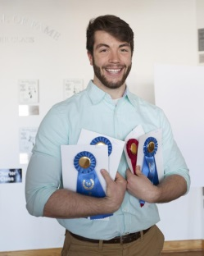
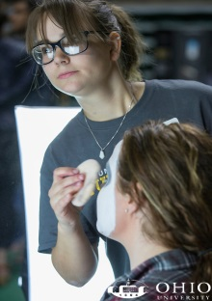
About the Expo
For the past 20 years, undergraduate, graduate and medical students have gathered to present their original work.
Projects have included documentary filmmaking, robotic lawn mowers, innovative theater costumes and presentations on the latest findings from medicine, astrophysics, education, and environmental science.

Slide 4
What to Expect…..
(Skip to Slide 5 if you have attended the Expo)
The judging, like the Expo itself, has some similarity to discipline-specific conferences/juried events, but it also has its own flavor.
The disciplines represented span the many interests and expertise of our university; the presentation formats vary from posters to exhibits and from performance to oration.
Unlike most events, the Expo has a unique blend of attendees – from middle school students to prospective undergraduates to university students, staff and faculty and community members.
Therefore, presentations are geared towards an informed lay, rather than a discipline-specific, audience.

Slide 5
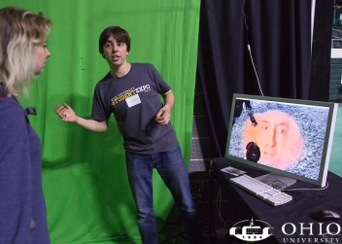
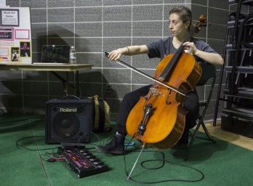
Session Assignments
Students are assigned to a session based on their home department/school.
Students may elect to have their presentations displayed only or displayed and judged.
Sessions are set at a minimum of 6 and a maximum of 10 judged presentations.
  Sometimes UG and G will be assigned separate sessions, e.g., Biol Sci–UG and Biol Sci–G.
  Other times, sessions will have both UG and G, e.g., Theater 1 and Theater 2.

Slide 6
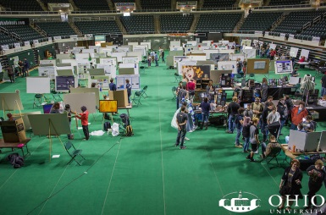
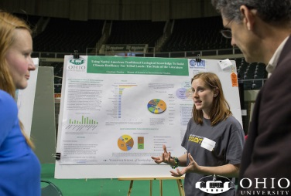
Judging Assignments
Two judges are assigned to judge each session.
Judges are assigned based on familiarity with the session subject area BUT are not assigned to their own department/schools.
If a judge has a conflict of interest in judging a particular presentation, then the judge should recuse themselves for that presentation.

Slide 7

Expo Schedule of Events for 2022
9:00 am –11:30 am judging [may vary depending session]
11:30 am – 2:00 pm open to public*

Slide 8
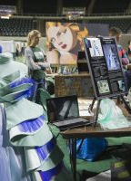
Judging Schedule
Come to the lower lobby at the Convo 15 minutes prior to the start of your session.
Judging clipboards with (1) judging criteria, (2) session assignments, (3) award forms and (4) a map of the Convo showing session locations will be arranged alphabetically by session on the tables.
Collect your clipboard and find your judging partner.
Judging assignments will be emailed prior to event. If you don’t know your partner, try to find a picture (e.g., dept. webpage) so you can ID them easily. You also may want to swap cell phone numbers.
Five minutes prior to judging, locate your session and scout out the locations of all the presentations.
All presentations will have a name and number, e.g., Theater 1, 209.
All presentations within a session will be co-located.

Slide 9
Judging Criteria for the Expo
IMPORTANT!
Judge the presentation of the work rather than the impact (intellectual merit) of the research/creative work.
Judge presentations in the order listed on the Session Assignment Sheet.

Slide 10
Judging Criteria for the Expo
Each presentation should have two parts:
Presentation of the pre-prepared materials, e.g., the poster, exhibit, or performance.
Follow up Q&A with the judges.
Different judging criteria may be more appropriate for different formats and are at the discretion of the judges.

Slide 11
Instructions We Gave to the Presenters
Introduce yourself to the judges.
State what you did.
State why you did it. Examples:
  What is the gap in the literature?
  What is the societal need?
  What vision did you have for the creative work?
State how you did it. Talk about your methodology.
State the (intended) outcomes of your project.
Detail how this will further/impact your field and society.
REMEMBER: Judges will be from related fields but not your specific discipline.

Slide 12
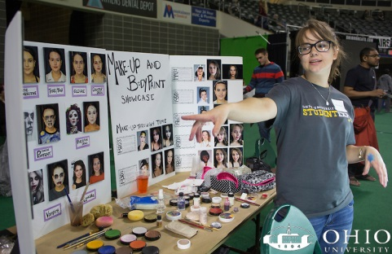
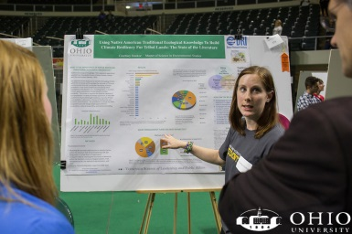
Suggested Judging Criteria: Posters
Attractiveness
  Don’t just give points for a glossy printing.
  Look at the presentation of the content.
Content flow
  Is the poster self-explanatory?
  Is the methodology clear?
  Are results well-presented and understandable?
Conclusion
  Do the results support the conclusions drawn?
  Does the conclusion follow the original intent?
  Is there creativity in the investigation?

Slide 13
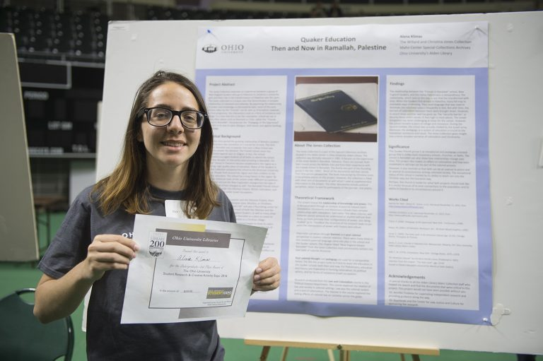
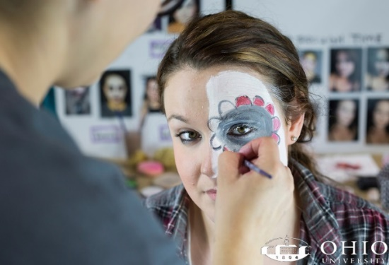
Suggested Judging Criteria: Exhibits/Performances
Attractiveness
  Don’t just give points for a glossy presentation.
  Look at the presentation of the content.
Content flow (if applicable)
  Is the exhibit self-explanatory?
  Are outcomes well-presented and understandable?
  Is there creativity in the presentation?

Slide 14
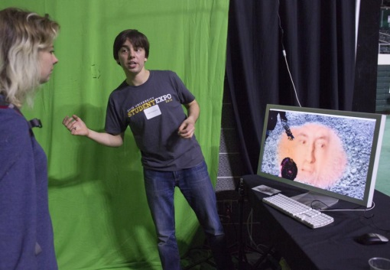

Suggested Judging Criteria for Q&A
Look for students who have taken ownership of their project and can explain:
Their role
The need or opportunity for the project
The methodology to a lay person
The project outcomes and strategies for continuation or dissemination of the project

Slide 15
Award Selection
Partner judges for each session must come to a consensus.
Mixed UG/G Session:
  Judges may elect to give two joint 1st place prizes:
    One for an UG student
    One for a G student [MA, PhD, medical].
    In this case a 2nd place prize will not be awarded.
  Expectations for UG vs. G students tend to be discipline specific and therefore will be at the discretion of the judging group.
UG or G sessions only:
  Judges must select a 1st and 2nd place prize.
Regretfully we do not have a mechanism in place to award additional prizes or honorable mentions.

Slide 16
2022 Awards
1st place: $150
2nd place: $75
Joint 1st place: $112.50
Some special sessions may make awards differently.

Slide 17
Award Selection Form
Each judging group will need to fill in a form. See example below.
[Copies will be provided along with a clipboard at the event.]
SESSION: ________________________________________________________________
1st Place Prize Recipient:
Name: _____________________________________________________________________
Status(UG/G/Postdoc/Med):_____________________________________________
2nd Place Prize Recipient:
Name: _____________________________________________________________________
Status (UG/G/Postdoc/Med):____________________________________________
OR
1st Place Joint Prize Recipient:
Name: _____________________________________________________________________
Status(UG/G/Postdoc/Med):_____________________________________________
1st Place Joint Prize Recipient:
Name: _____________________________________________________________________
Status (UG/G/Postdoc/Med):______________________________________________

Slide 18
FAQs
What if…..
I cannot find my judging partner.
  Call your partner’s cell phone number.
  Check in with Roxanne in the downstairs Convo lobby. She will try to track down your partner.
  In some rare circumstances, you will be asked to start the judging alone and your partner will join you when they arrive.
We cannot find a presentation.
  Look for a staff member or call 740-591-0930 for Roxanne. They will have access to a Convo layout map with all presentation locations.

Slide 19
FAQs
A presenter is not ready at their designated time.
  You may:
    skip to the next IF AND ONLY IF the next presenter approves the change in schedule and come back to the first presentation during the next time slot; OR
    wait the full 15 minutes for the presenter. If they arrive late, they only have the remaining minutes of their slot to present.
It is at the judges’ discretion if they will allow an absent presenter to make up their judging presentation at a later time.

Slide 20
FAQs
The premise or methodology of the project seems flawed.
  While it is appropriate to probe a presenter about their premise/methodology to seek clarification and use their response to gauge their presentation, it is not appropriate to judge the validity of their methodology itself.
  Remember: judges are directed to judge based on the presentation of the work rather than the impact (intellectual merit) of the research/creative work.

Slide 21
FAQs
The outcomes/broader impacts of the work seem limited.
  Remember: judges are directed to judge based on the presentation of the work rather than the impact (intellectual merit) of the research/creative work.
  The scope of the projects and often the impact will vary, especially for UG vs. G projects.
  Focus your questions on the student’s knowledge of the need/opportunity for the project, their role, and the strategies for continuation of or dissemination of the project.

Slide 22

What to Do If You Need Help at the Event
Staff, including Roxanne, will be available to assist judges during the judging and deliberations.
If you have questions, look for a staff member or call 740-591-0930.

