Slide 1
Height Adjustable Workstation Assessment
Ohio University, Athens
Team Members:
Chris Rasch
Xiaodong Song
Seth Taylor
Erik Blotzer
Client: Marty Dagostino
Advisor: Diana Schwerha
Instructor: Gary Weckman

Slide 2
Introduction
Studies show extensive sitting is unhealthy¹
  Heart disease, obesity, type 2 diabetes, muscular and skeletal issues
Height adjustable workstation could help change this and improve worker comfort and productivity
Some faculty and staff at OU already utilize this type of table and requests for them have increased
No in-depth follow up study has been done to evaluate the impact of adjustable workstations at Ohio University
¹2010 American Cancer Society study, “Leisure Time Spent Sitting in Relation to Total Mortality in a Prospective Cohort of US Adults”
Height Adjustable Workstation Assessment

Slide 3
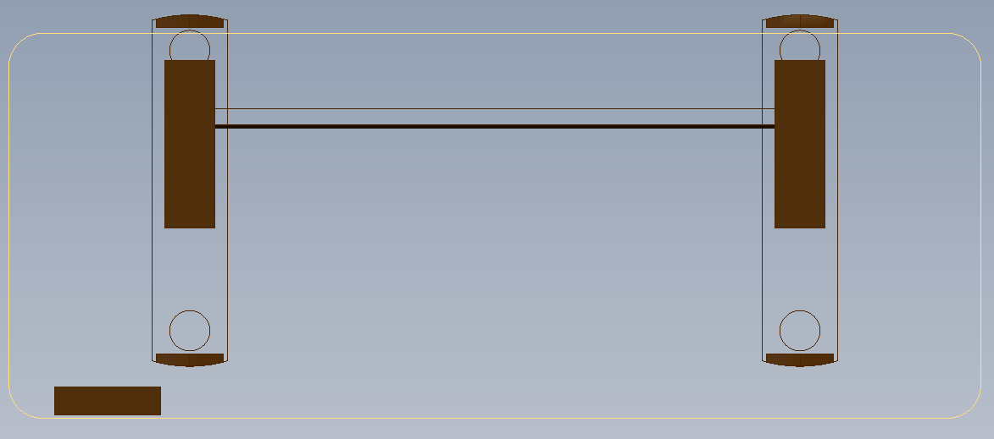
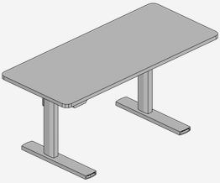
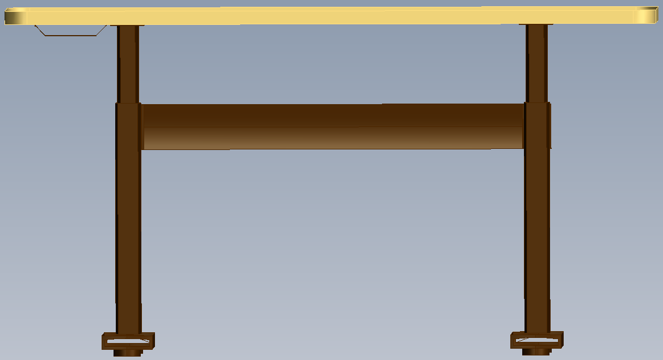
Introduction
Example: Steelcase Series 7
  Programmable and powered by electricity
Height Adjustable Workstation Assessment

Slide 4
Project Definition
Business Reason
  Height Adjustable Workstations are in use, no follow up has been done to assess their effectiveness or return on investment
    Push-button, programmable ~ $1400
    Retrofit adjustable kit ~ $800
Opportunity Statement
  Determine if adjustable workstations have an effect on worker pain and productivity
Height Adjustable Workstation Assessment

Slide 5
Expected Benefits
Goals Addressed by this Project
  Assess if adjustable workstations have an effect on worker comfort and productivity
Benefits to Ohio University
  Gain information regarding the effects of adjustable workstations
Benefits to OU Employees
  Increased willingness of OU to provide employees with adjustable workstations or encouragement for OU to explore other options to make workers more comfortable
Height Adjustable Workstation Assessment

Slide 6
Process Flow
Create the Survey
Researched pain scales and similar surveys
Created multiple drafts of the survey, got feedback
Send Out the Survey
For ease of completion and collection, we did not use hard copies
Collect Data from the Survey
Data was recorded and viewed through the Qualtrics website
Analyze the Data
Complete a Cost-Benefit Analysis
Make Final Recommendation
Sent out using the online survey platform Qualtrics
Determined actual KPIVs, time spent for pain related breaks
Determine if the cost of each workstation is justified by the potential benefits
Determine if adjustable workstations are a worthy investment for Ohio University
Submitted project proposal and survey draft to IRB
Height Adjustable Workstation Assessment

Slide 7
Cause and Effect Diagram
*Items boxed in red are what we believe to likely be KPIVs
Height Adjustable Workstation Assessment

Slide 8
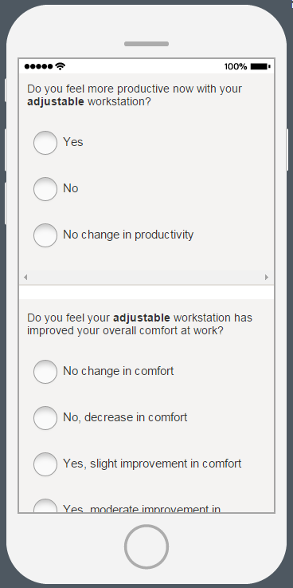
Survey Layout
Survey was conducted through Qualtrics
Survey questions were separated into 6 sections
  General Information
  Typical Workday
  Workstation and Posture
  Pain and Discomfort
  Productivity
  Personal Opinion Questions
Height Adjustable Workstation Assessment

Slide 9
Original Workflow Diagram
Individual Requests an Adjustable Workstation
Marty Installs the Workstation
No Feedback is Received
Height Adjustable Workstation Assessment

Slide 10
Updated Workflow Diagram
Individual Requests an Adjustable Workstation
Marty Installs the Workstation
Feedback is Received from Survey Respondents
Height Adjustable Workstation Assessment

Slide 11
Process Analysis
After the survey was completed, we analyzed the data and made inferences
  Looked for correlations between how they use the workstation, their daily habits, etc., and their reported pains
Cost-Benefit analysis was performed comparing…
  Cost of adjustable workstation
  Savings associated with change in productivity
Height Adjustable Workstation Assessment

Slide 12
KPIVs
Correlation values were calculated for different factors that could contribute to a worker’s pain
KPIVs were determined to be:
  BMI: r=0.488
  Hours standing outside of work: r=0.500
  Age: r=0.687
  Number of position changes: r=0.588
    (N=15, α = 0.1)
Correlation does not always mean causation
Height Adjustable Workstation Assessment

Slide 13
Average Frequency of Pain
Sometimes
Rarely
Never
Height Adjustable Workstation Assessment

Slide 14
Any Pain Severe?

Slide 15
Breaks
Average reduction in break time per day to relieve pain: 7.7 minutes
Height Adjustable Workstation Assessment

Slide 16
Personal Opinions of Adjustable Workstations
Feel more productive?
  73% say yes, 27% say no change
Improved overall comfort?
  93% say between moderate and significant improvement, 7% say no change
Improved overall mood?
  93% say yes, 7% say no change
Would you recommend HAW to others, with or without pain?
  100% say yes
Height Adjustable Workstation Assessment

Slide 17
Summary of Results
Frequency of pain
  Decreased in 6 of 8 areas, but increased in the feet
Severity of Pain
  Decreased in all areas except feet and legs where it increased
Length of breaks due to pain or discomfort
  Fewer and shorter breaks required to relieve pain
Overall Opinion
  More productive, increased comfort, improved mood, would recommend HAWs to everyone
Height Adjustable Workstation Assessment

Slide 18
Findings from Other Studies
Effects of An Electric Height-Adjustable Worksurface on Self-assessed Musculoskeletal Discomfort and Productivity in Computer Workers
  Alan Hedge of Cornell University, 2004
  Found significant decrease in severity of pain in shoulders, neck, upper back, lower back, forearms, wrists, and hands
  Found slight significant increase in frequency of pain in the same areas
  Lower increase in discomfort ratings throughout the day
  57.2% said it “somewhat/definitely helped” with productivity
  82.4% of participants preferred the EHAW
Height Adjustable Workstation Assessment

Slide 19
Findings from Other Studies
Reducing Occupational Sitting Time and Improving Worker Health: The Take-a-Stand Project
  Pronk, Katz, Lowry, and Payfer, 2011
  Time spent sitting reduced by 66 min each day
  Reduction of upper-back and neck pain by 54%
  Increased mood and vigor, decreased depression, confusion, and tension
  All observed changes went away after FHW was replaced
Height Adjustable Workstation Assessment

Slide 20
Cost-Benefit Analysis
Assumptions:
  Average Salary: $59,000
    Calculated from average salaries from professions reported by respondents
  251 working days in a year
  8 hours working each day
  Equates to $29.45 per hour or $0.49 per minute
  $1400 for adjustable workstation
Could not find figures relating to adjustable workstations and reduction in MSD claims so analysis is based on productivity increase
Height Adjustable Workstation Assessment

Slide 21
Cost-Benefit Analysis
$948 saved per year on reduced break time
1.47 year payback period
Height Adjustable Workstation Assessment

Slide 22
Recommendation
We recommend for Ohio University to consider purchasing and installing more height adjustable workstations around campus to promote productivity and the greater wellness of its faculty and staff
Height Adjustable Workstation Assessment

Slide 23

Create
for Good.

