Slide 1
Business Forum
February 6, 2019
Baker University Center 240

Slide 2
Agenda
Budget Update and Partner Group
Accounting and Reporting Partner Group
Key Announcements

Slide 3
Budget Partner Group
Co-chairs:
Katie Hensel Budget Director, Budget Planning and Analysis
Mike Finney Chief Financial and Administrative Officer, Voinovich School of Leadership and Public Affairs

Slide 4
Agenda
Budget Partner Group Charge
Budget Partner Group Representation
FY18 Accomplishments
FY19 Budget Partner Group Goals
FY19 Budget Partner Group Metrics
Progress on FY19 Goals
FY20 Budget Planning & University Priorities
FY20 Budget Timeline
Discussion Questions

Slide 5
Budget Partner Group Charge
To facilitate productive communications between the planning units and the Office of Budget Planning and Analysis to enhance the tools, training, and resources that make the annual budgeting process efficient, meaningful and accurate.

Slide 6
Budget Partner Group Representation
The Budget Partner Group is co-chaired by the Director of Budget Planning & Analysis and a member of the RC Strategy Group, as selected by the RC Strategy Chair. The RC Strategy Group Co-chair will serve a two-year term.
RC-Strategy Co-Chair:
Mike Finney, CFAO of the Voinovich School
All campus planning units have at-least one member on the committee.

Slide 7
FY18 Outcomes
Improved the timeliness and accuracy of the University’s Original Budget Load, as compared to prior years
Improved timeliness and scope of planning unit Budget Book submissions, including:
Published narratives
Reviewing and validating dashboard information
Expanding the scope of the enrollment assumptions published in the FY19 Budget Book

Slide 8
FY19 Budget Partner Group Goals
Enhance existing tools and develop new tools that facilitate efficient budgeting
Train members on how to effectively budget and estimate revenues and expenses
Facilitate dialogue among members to encourage the sharing of ideas and techniques used across the University for effective budgeting
Communicate best practices in budgeting to other planning units
Better communicate the status of the University’s strategic priorities and budget process

Slide 9
FY19 Budget Partner Group Metrics
Metric #1: Expand Templates and Tools Deliverables
Goal: Increase the number of Templates and Tools meetings to identify how OBI catalog report training and additional tool development can enhance budget preparation
Metric #2: Measure Annual Budget to Actual Expense Variance
Goal: Improve variance between budgeted and actual (direct) expenses over time
Metric #3: Begin the Development of a Compensation Forecasting Model
Goal: Through the Templates and Tools Work Group begin the development of a compensation forecasting model that planning units can utilize for budgeting and faculty/staff FTE counts; incorporating best practices from planning units

Slide 10
FY20 Budget Development & University Priorities
Budget Partner Group will integrate the following University priorities into the FY20 multi-year budget process:
Adoption of President Nellis’ 2025 Strategic Plan: Extending the FY20 multi-year budget submissions to include FY24 and FY25
Integrating the goals of the Strategic Executive Enrollment Committee (SEEC) into the Academic College budget planning assumptions
With the long-term goal to develop budget tools that balance and track:
Strategic Use of Reserves
Planning Unit Targets; established to streamline operations and meet the changing enrollment demographics within public higher education

Slide 11
FY20 Athens UG Enrollment Assumptions
Fall UG Athens Headcounts: Fall Vs Spring Planning Assumptions from SEEC
17,752
17,292
17,120
17,080

Slide 12
Graduate Headcount Projections
Fall Graduate Headcounts: Updated SEEC Projections

Slide 13
Ongoing FY20 Budgets Discussions
Integrating the SEEC enrollment assumptions into the FY20 budget planning assumptions
Communication of enrollment goals to planning units
Validate college submissions to ensure academic enrollments = SEEC goals
Develop tools for tracking and reporting multi-year enrollment goals and measuring the financial impact to the institution
FY20 Raise Pool
Strategic priority of executive leadership
FY20 raise pool discussion, ongoing as part of spring budget planning

Slide 14
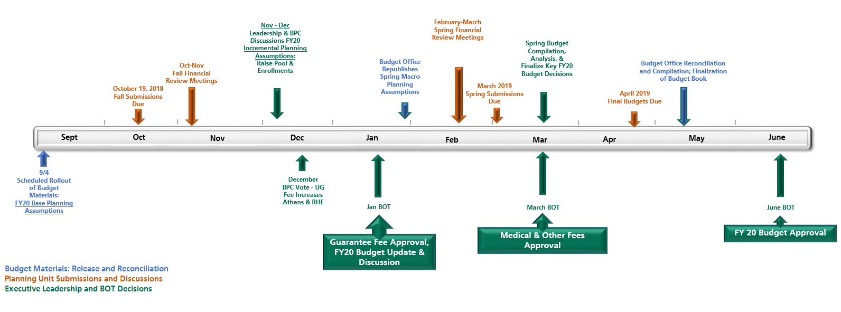
FY20 Budget Planning Timeline

Slide 15
Additional Questions?
Contact:
Mike Finney- finney@ohio.edu
Katie Hensel - hensel@ohio.edu
Feedback is always welcome…

Slide 16
Accounting & Reporting Partner Group
Co-chairs:
Kris Sano, Director, General Accounting & Financial Reporting
Kari Saunier, CFAO, College o Fine Arts

Slide 17
Agenda
Charge
Representation
Accomplishments
Goals
OBI – GL Funds Available View Default Change
Feedback/ Questions

Slide 18
Accounting & Reporting Partner Group Charge
Review processes, tools, documentation/training
Work collaboratively to improve the efficiency and quality of our accounting practices and controls
The initial scope of this Partner Group will also develop specifications for improved financial reporting from the General Ledger, Grants, Payroll, Receivables, and Cash Management.

Slide 19
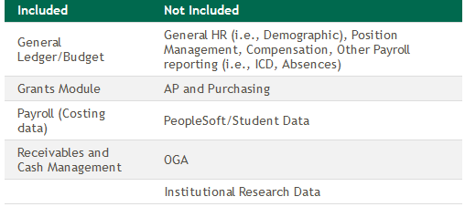
Accounting & Reporting Partner Group
The table below describes what is and what is not included in the scope of this group:

Slide 20
Accounting & Reporting Partner Group Representation
Arts & Sciences – Carrie Horvath
Business – Jessica Creamer
Communications – Emily Chapman
Education – Beth Lydic
Engineering – Becky Maccombs
Foundation – Bo Richardson
Health Sciences – Tia Barrett
OGAIS – Rachael Davis
Voinovich School – Gina Johntony
HCOM – Kelly Coates
Regional Campuses – Rosanna Howard
Student Affairs – Megan Vogel
VPF&A Business Service Center – Moriah Hudspeth

Slide 21
Accounting and Reporting Partner Group Accomplishments
Identified and prioritized needs for OBI reporting
Single column for more dynamic Funds Available View searching by chart of accounts segment
Modification to Funds Available View drill-downs to include function

Slide 22
Accounting and Reporting Partner Group Goals
Vetting and supporting the integration of budget into the dashboard reports
Mocking up/screenshots of what we would like to have implemented
Testing improvements prior to roll outs, especially related to group suggestions
Support new chart of accounts and accounting considerations
Develop tricks and tips for various tabs within OBI reports

Slide 23
GL Funds Available View – Default Change
OBI - Finance Dashboard
Our proposal will not change the functionality
It will only change the default view when you click on GL Funds Available

Slide 24
GL Funds Available View – Default Change
Current – “Revenue Expense” View:

Slide 25
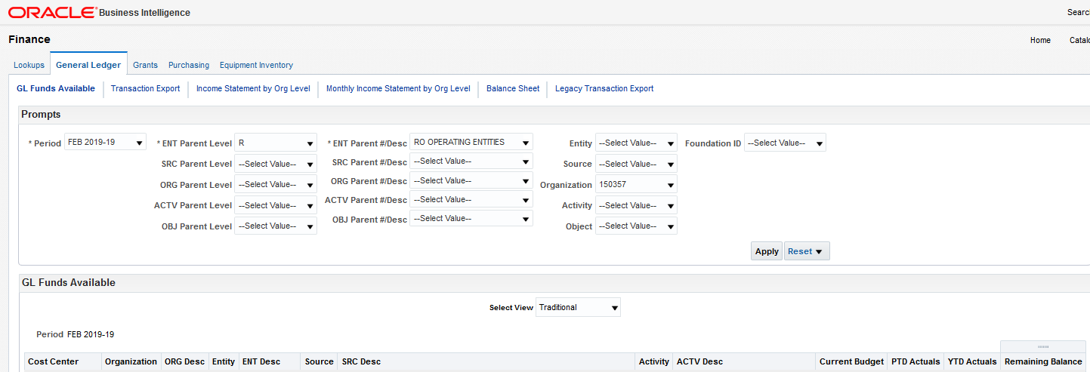
GL Funds Available View – Default Change
Proposed – “Traditional” View

Slide 26
GL Funds Available View – Default Change
Both views will still be available via the drop-down
The “Traditional” view will just be the new default
Belief that most users manage to a budget and therefore are more likely to utilize the “Traditional” view

Slide 27
GL Funds Available View – Default Change
Next steps:
Communication via Business Matters and an email distribution list for GL Funds Available users
Then Finance will coordinate timing to make change

Slide 28
Discussion Questions
Please share Accounting or Reporting feedback to your partner group representative or email a co-chair

Slide 29
Questions?

Slide 30
Transportation and Parking website
Launched in new WebCMS on January 3, 2019
Merged separate Transportation Services site and Parking Services sites
New URL: www.ohio.edu/transportation-parking
Navigation based more on service offerings

Slide 31
Human Resources Website
Launched in new WebCMS on January 7, 2019
Organized by function, not department
Highlights:
New searchable forms page
Consolidated systems access
Clearly defines when to go to ESC or HR Liaison
Follow-up survey in March

Slide 32
Finance Updates
Julie Allison Associate Vice President, Finance

Slide 33
Agenda
Purchasing Updates
Red Flags Policy
Federal Equipment Inventory
Travel Update
OBI Training Update

Slide 34
Purchasing Update
BobcatBUY Upgrade Coming in March/April
First software release for 2019 available for testing March 17, 2019
Go live set for early April
New features will be communicated closer to go live
3 annual updates – April, July and November
Purchasing Training Update
Developing a Preferred Supplier Purchasing course through PDP
Provides processes and tools to aid in understanding purchasing from preferred suppliers.
Deployment is planned for March

Slide 35
Purchasing Policy Update
Combining the following policies into one purchasing policy, 55.030
55.003, “Purchasing Authority: Vendor Selection, Personal Purchases, Land and Building Acquisition, Conflict-of-Interest”
55.012, “Purchasing – Direct Payment”
55.031, “Purchasing – Radioactive Materials, Narcotics, Hazardous Materials, Animals, and Tax-Free Alcohol”
55.040, “Purchasing – Receipt of Items: Notifications, Damages, Shortages, Returns”
55.050, “Purchasing – Ohio University Foundation Accounts”
55.060, “Purchasing – Blanket Purchase Orders”
Currently under review by P2P Partner Group
Procedure will be stripped from policy and made available to campus
Policy 55.007 “Competitive Bidding” to remain separate

Slide 36
Red Flag Rules – Policy 48.001
Required by the Federal Trade Commission (FTC) under the Fair and Accurate Credit Transactions (FACT) Act of 2003
Purpose of the Red Flags Rule
To detect and stop identity thieves from using someone else’s identifying information at our institution to commit fraud.

Slide 37
Red Flag Rules – Policy 48.001
Program Requirement
Any business that offers or connects customers to credit must implement a written Identity Theft Prevention Program to detect, prevent, and mitigate identity theft in connection with a covered account.
The law defines “creditor” as any entity that regularly defers payments for good or services or arranges for the extension of credit. This includes offering a payment plan.
A “covered account” is defined as a consumer account that allow multiple payments or transactions or any other account with a reasonably foreseeable risk of identity theft.

Slide 38
Red Flag Rules – Policy 48.001
Covered Accounts Include (but are not limited to):
Student Bursar Account
Student loans
Bobcat Cash Account
Patient/Client Accounts (including WellWorks, clinics, etc.)
Program/Travel/Research/Payroll Advances

Slide 39
Red Flag Rules – Policy 48.001
Examples of Red Flags:
Warning from consumer reporting agencies
Fraud alert included in consumer report
Suspicious documents
Documents provided for identification appear to be altered
Suspicious personal information
Inconsistent with other information sources
Notice from customer
Customer notifies institution about identity theft

Slide 40
Red Flag Rules – Policy 48.001
Responding to Red Flags
Once a red flag or potential red flag is detected, the employee must act quickly to gather all related documentation and present it to the department supervisor. The supervisor should then work with the Program Administrator (Controller) or her designee to determine whether the transaction was fraudulent or authentic. Appropriate responses may include:
Monitoring account for evidence of identity theft
Contacting the customer
Changing any passwords, security codes, or other security devices that permit access to the account
Notifying law enforcement
Determining no response is warranted under the particular circumstances

Slide 41
Red Flag Rules – Policy 48.001
Training
The Red Flags Rule requires that relevant staff receive training. Who needs training?
Staff directly involved in the customer identity verification process
Staff who respond to customer inquiries
Staff who have the type of access to account information such that they could recognize potential red flags in account activity

Slide 42
Sponsor Equipment
Equipment vested with the sponsor (per sponsor guidelines) and in the permanent possession of Ohio University must be tracked as sponsor equipment
Contractor Acquired – equipment purchased using expenditure type 715210 Equipment Title Vested in Sponsor
Government Acquired – equipment provided to Ohio University by sponsor and title vested in sponsor
Notify Grants Accounting at finance.grants@ohio.edu when equipment is Government Acquired
Equipment is identified with a red tag starting with an 8
The Equipment Inventory dashboard provides the ability to track asset(s) by Sponsor Equipment

Slide 43
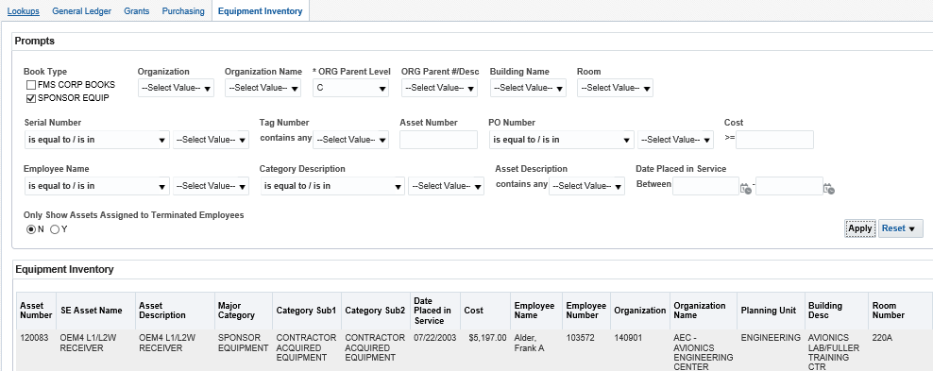
Equipment Inventory Dashboard
Login to OBI using: https://obiprd.oit.ohio.edu/
Enter OHIO ID and password
Click Dashboards > Finance > Equipment Inventory

Slide 44
Indirect Cost Rate
Department Health & Human Services approved IDC extension of current rates through June 30, 2022
Proposal for new rate due by December 31, 2022
New rate would be effective July 1, 2023
Rates remain the same
Research – 51%
Instruction – 49%
Public Service/Other Sponsored Activities – 39%

Slide 45
Red Tag Equipment Certification
Grants Accounting certifies red tag inventory
Physical audit completed and department signs form certifying that inventory is current and accurate
Equipment must be used in the program or project for which is was acquired as long as needed per Uniform Guidance §200.313(c) Equipment
Equipment no longer needed for the original purpose must be reported to the federal agency for disposition instructions by contacting Grants Accounting at finance.grants@ohio.edu

Slide 46
Travel Update
February 5, 2019: Concur Expense Upgrade
Business Matters, OEN, & Direct emails to employees who created an expense report since January 2018
Concur User Interface Upgrade QRG
April 1, 2019:
Updated Travel Policy
Procedures being developed – expect to release procedures during comment period so we can start to review/address questions
Christopherson Implementation & Reconfigure Online Booking Tool in Concur
Updated PCard Policy & Procedures (tentative timeline)

Slide 47
Travel Feedback & Focus Groups
Met with 100+ faculty and staff throughout December and January with the following goals
Socialize and spread awareness of new travel provider
Share timeline details
Ask questions related to potential policy/procedure changes
Listen to general concerns related to Travel policy, procedure, experience
Groups
December ‘18: Faculty & Researcher Focus Groups
December ‘18 - ‘19: Staff Feedback
Meetings with frequent travel bookers & staff travelers with each Planning Unit
Identified by CFAOs
December 2018 - January 2019: Specialty & Group Feedback
Advancement, OGAIS, Athletics, Student Affairs, Marching 110
Campus partners include Travel Services Working Group, P2P Partner Group and RC Strategy
Feedback was used to inform recommendations to the travel policy, develop FAQs, and will be used to help define travel procedures

Slide 48
Travel Update
41.121 – Reimbursement for Official Travel and Entertainment
Executive Staff Policy Committee – 1/25/19
Expect to release policy for comment the week of February 4th
Policy Reviewers
Senates
Internal Audit
Risk Management and Insurance
Deans and Chairs
Chief Financial & Administrative Officers
Vice Presidents
Director, Office of Education Abroad
Controller’s Office
Director of Transportation
Tax Management

Slide 49
Travel Update
Major Changes
Preferred Supplier required in most cases
Allows for “approved payment methods”
Move from mix of per diem and actuals to per diem only
Procedures have been removed that will be included in a procedures document, referenced at the end of the policy
Communication – this week
Publish Fee Schedule
Cost Scenarios

Slide 50
OBI Course Update
OBI Reporting
2 courses now available
Oracle Business Intelligence (OBI) Navigation
Oracle Reporting Fundamentals
Reviews all major dashboards including prompts, data, and drilldowns

Slide 51
OBI Reports/Tools Update
Report Updates
Payroll Forecasting Dashboard
Grants Funds Available – added period to date (PTD) expense column (Grants PG)
Grants Effort Reporting Dashboard
Equipment Inventory Dashboard – added ORG parent prompts for enhanced reporting
Tools Update
Added Account Validation Tool (AVT) to Finance>Resources page
Cost Center – added text referring people to AVT for new combinations. This lookup does not display all valid combinations, but only those that have been used in the system. To check if a combination of segments is valid in Ebiz, use the AVT which performs real time validation for accounts strings.

Slide 52
OBI Reports – Work in Progress
Bursar – Item Type dashboards – incorporate GL parent values and Grants Task Org hierarchy (previously only used ranges of segment values) – can produce combined GL/Grants report for any level of Org hierarchy
GL - Bridging TBS (The budget sheet) categories for financial statements
GL Funds Available – adding Grants Source flag to output to identify cost centers that summarize Grants activity
Grants AR dashboard – developing dashboard for reporting on open AR Grants invoices (Grants PG)
Developing JET for uploading GL/Grants journal entries directly to eBiz

Slide 53
Next Business Forum
Tuesday, April 9 9-11 AM
HRTC 141-45

