Slide 1
Business Forum
October 10, 2017 2-4 p.m.
HRTC 141-45

Slide 2
Agenda
Welcome/Intro
Post Awards and Grants Partner Group Presentation
Payroll Partner Group
Compensation Partner Group
Key Announcements

Slide 3
Post Awards and Grants Partner Group
Luanne Bowman: Chief Operating Officer Russ College of Engineering and Technology
Cindy Perry: Director Grants Accounting

Slide 4
Agenda
Mission
Representation
Goals
Vacation and Sick Leave payout
Cost share process
Uniform Guidance – Procurement Standards

Slide 5
Post Awards and Grants Partner Group Charge
The Post Awards and Grants Partner Group is charged with developing solutions to issues that impact the application, implementation and accounting for external awards.

Slide 6
Representation
Co-chairs
Luanne Bowman, Russ College of Engineering and Technology
Cindy Perry, Grants Accounting
Membership
Connie Pollard, College of Arts and Sciences
Beth Tragert, College of Health Sciences and Professions
Kelly Coates, Heritage College of Osteopathic Medicine
Linda Shapiro, Heritage College of Osteopathic Medicine
Chip Rice, Patton College of Education
Shannon Bruce, Russ College of Engineering and Technology
Mike Finney, Voinovich School
Thea Arocho, Office of Research and Sponsored Programs
Keith Leffler, Vice President for Research

Slide 7
Post Award and Grants Partner Group Goals for FY18
Current identified issues that have impacted or will impact sponsored research
Accounting for vacation and sick leave payout for grant-funded personnel
Cost share process to ensure expenditures are tracked
Uniform Guidance – Procurement Standards implementation
Information on audits and best practices
Other areas that may be identified as the group meetings continue throughout the year

Slide 8
Vacation and Sick Leave pay out
How can research centers cover vacation payouts or extended sick leave costs for soft-funded employees?
Paid Time Off (PTO) for all employees is accrued in accordance with University Policy
This accrual of PTO occurs as researchers work on specific projects but the time/cost is not factored into the direct charges to the project, therefore creating a financial gap.
For long-term research employees who have accrued maximum PTO balances, this can create a significant financial burden on a Center when employees utilize the PTO to which they are entitled, or terminate, which results in an unused vacation payout.

Slide 9
Vacation and Sick Leave pay out
Next Steps on this issue for the group:
Review how various units handle PTO for soft-funded employees – including how large research centers handle the financial burden
Review data which shows the current PTO liability for soft-funded employees within the colleges
Discuss possible alternatives for a methodology to recoup these costs and offset the financial liability

Slide 10
Cost Share process
Goal is to have a cost share account set up at time of award
Ensures accurate monitoring and tracking of expenditures
Ensures cost share is being recorded and obligations are being met:
Mandatory: required per grant award
Voluntary Committed: not required by sponsor but in proposal or budget
Program Income: fee income from usage fees
In-kind: third party cost share

Slide 11
Uniform Guidance: Procurement Standards
Micro-purchase threshold standards:
Effective July 1, 2018
Apply to federally-funded purchases
Threshold set at $3,500
Requires three quotes

Slide 12
Discussion Questions
Are there post award, grant, sponsored research issues that the broader University community would like to see this group investigate?

Slide 13
Questions?
Luanne Bowman: bowmanl3@ohio.edu
Cindy Perry: perryc@ohio.edu

Slide 14
Payroll Partner Group
Bridget Driggs: Payroll Operations Manager Human Resources
Kari Saunier: Chief Financial and Administrative Officer College of Fine Arts

Slide 15
Agenda
Partner Group Charge, Vision and Goals
Membership List
ICD Collaboration with Comp Partner Group
Future plans

Slide 16
Payroll Partner Group – Charge
The Payroll Partner Group is charged with developing solutions to improve the University payroll process in conformance with the goals determined by University leadership.
Areas of focus for improvement will include:
Communication
Payroll processes
User needs and challenges
Technology and tools
Change management

Slide 17
Payroll Partner Group – Vision
The Payroll Partner Group will facilitate productive discussions regarding payroll processes related to process improvements, change management, and training while exploring options to better utilize payroll data, thus improving University templates, tools, and processes.

Slide 18
Payroll Partner Group – Goals
To better utilize payroll data, thus improving templates, tools and processes
To ensure end users are given opportunities for input and well-informed of process changes
To provide support, guidance, and documentation to end users so they are knowledgeable of payroll processes (including, but not limited to, how to process contracts/timesheets, the distinction between contract types, methods for correcting and modifying payroll details, and who to contact for what types of situations)

Slide 19
Membership

Slide 20
Individual Compensation Distribution
Collaboration with Compensation Partner Group
Helped review workflow approval process
Intend to help review training plans

Slide 21
Future Plans
Payroll data
Consistent usage and/or reporting available amongst Human Resources and Budget processes
Will kick off work after FSE changes-early February
Other Items?

Slide 22
Questions?
Payroll Partner Group co-chairs:
Kari Saunier: saunierk@ohio.edu
Bridget Driggs: driggsb@ohio.edu
Partner Group Members:
Valerie Denney
Carrie Horvath
Jessica Creamer
Mindy Colburn
Carlotta Hensler
Janet Howard
Deborah Daniels

Slide 23
Compensation Partner Group
Megan Vogel: Special Assistant to the Vice President for Student Affairs/Director of Resource Administration Division of Student Affairs

Slide 24
Compensation Partner Group
Charge
The Compensation Partner Group is charged with reviewing existing policies and developing new policies and/or procedures regarding compensation of employees at Ohio University
Goals
Review Pay Administration Guidelines
Provide oversight of the development of performance management tools
Create consistency in annual raise pool allocations
Define Overload processes

Slide 25
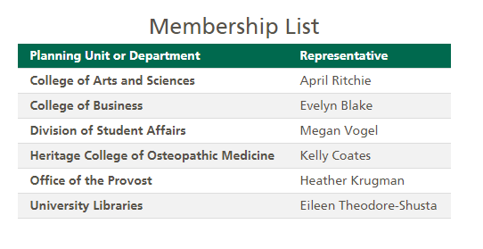
Membership Changes

Slide 26
Compensation Partner Group Update
Individual Compensation Distribution
Will launch alongside new Chart of Accounts (COA)
Will replace EMS for contract submission
Academic Term Pay
Additional Pay
Additional Salary*
Fiscal Increment*
Instructional Overload
Non-Instructional Overload
PT Contract Pay
Summer Research
Summer Term Pay
Employee Recognition Awards
Contract Pay
Early Retiree Pay
*will be available for Reappointment

Slide 27
Compensation Partner Group Update
Individual Compensation Distribution
Approval workflow
Contracts should be entered early enough to ensure time for approval process so employees are paid on time
Departments can set their own approvers through FARM
Administrative and Classified contracts for additional administrative duties will have Compensation level of approval
Training planned for mid to late November and will be communicated soon

Slide 28
Compensation Partner Group Update
Individual Compensation Distribution
Sample of possible workflow for an instructional overload with the employee teaching for another Planning Unit
Initiator creates and submits request for Overload for employee
Sent to employee’s supervisor/employee’s department chair for approval
Employee’s Planning Unit Approver reviews and approves
Planning Unit Approver of department the employee will be teaching for reviews and approves
If overload is over 25% of employee’s base salary, contract will be sent to the office of Associate Provost for Faculty & Academic Planning for approval
Payroll reviews for accuracy and makes final approval
Contract is approved and pay element in Oracle is created. Employee will receive an email FYI
*At any time within this process, a contract can be rejected, returned for corrections, or delegated to someone else for approval.

Slide 29
Questions?
Please contact compensation@ohio.edu, payroll@ohio.edu or one of the members of the Compensation or Payroll Partner Groups

Slide 30
Dual Career Network Enhancements
Designed to help partners of new employees in networking and locating employment opportunities in the Athens area
New features added to increase perception of “touch” and differentiate us from schools with which we compete
Enable area businesses to search our candidates on demand
Website is updated and includes a new brochure you may wish to distribute to candidates during interviews
https://www.ohio.edu/hr/employment/dual/

Slide 31
Dual Career Network Enhancements
New services include:
Bobcat Community Card
OHIO email account (guest user)
Bobcat CareerLink Access
Access to the Career and Leadership Development Center
More engagement with area employers
https://www.ohio.edu/hr/employment/dual/

Slide 32
OHIO Ready Staff Updates
Training will include the new Chart of Accounts
OBIEE Dashboards
COA Fundamentals and Casual User Training
New Hires:
Renee McGlamery
Virginia Ferrell
Start Date: October 9, 2017
Unit Deployment Date: November 1, 2017
Website Update

Slide 33
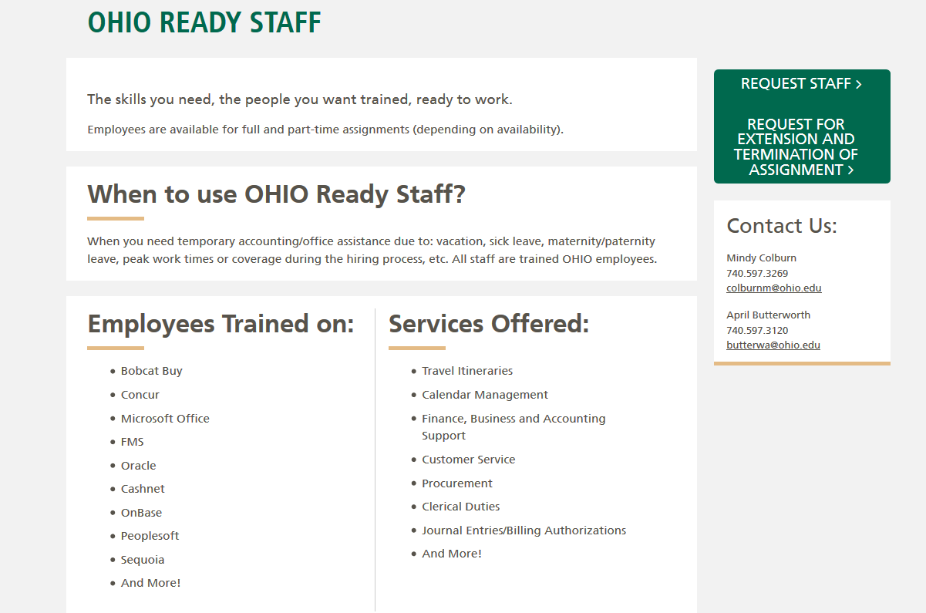
Website Update
www.ohio.edu/ohio-ready-staff

Slide 34
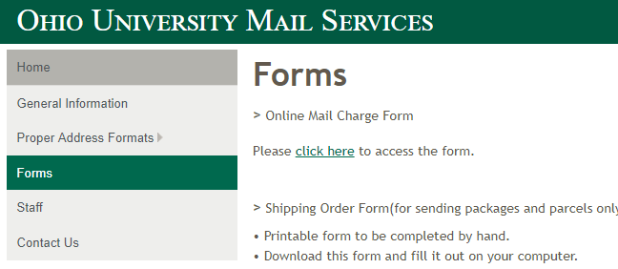
Mail Services Account Change
New mail charge form will go live December 12
Identify staff in your area that use this form
Create updated forms
https://www.ohio.edu/mail/forms.cfm

Slide 35
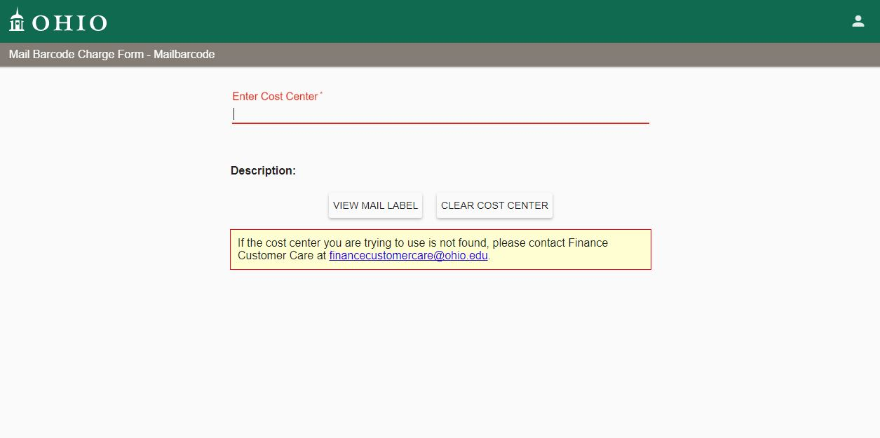
Mail Services Account Change

Slide 36
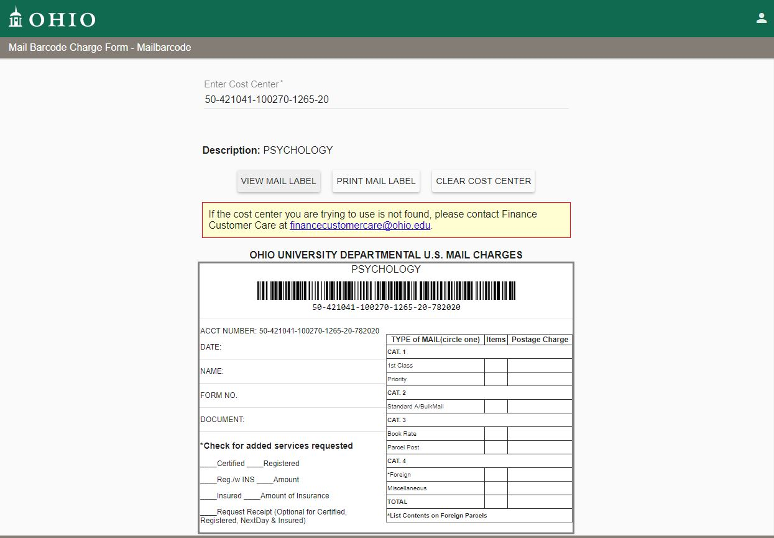
Mail Services Account Change

Slide 37
Capital Project Process and System Development
Topic | Dates | Notes
PIF/PAR Testing | October 15 – 31 | A pilot group will test the PIF/PAR process. Communication will be sent to the group on October 6,2017. If you would like to be added to the pilot group, please contact the Project Manager (information below).
 | November 6, 9:00am – 9:45am
 | November 6, 10:00am – 10:45am
PIF Training | November 6, 11:00am – 11:45am
 | November 7, 9:00am – 9:45am
 | November 7, 10:00am – 10:45am
 | November 7, 11:00am – 11:45am
 | November 3, 9 to 9:45 a.m.
PAR Training | November 3, 10 to 10:45 a.m.
 | November 3, 11:00am – 11:45am
PIF/PAR Implementation | November 12 | Guidance will be provided on the following unit’s websites: Architecture Design & Construction Capital Projects Finance Facilities Management & Safety Real Estate Management University Planning
Please refer to the article published September 26 to sign up for PIF and PAR training opportunities.
Notes:
Project Initiation Form (PIF) and Project Approval Request (PAR) will be implemented this fall and training will be available for PIF training on November 6 and 7 and PAR training will be held November 3. Please refer to the article published September 26 to sign up for the PIF and PAR training as needed.

Slide 38
Affordability and Efficiency Work Group
Presenters
Diana McGrew
Heather Krugman

Slide 39
Work Group Representation
Heather Krugman – Co-Chair
Diana McGrew – Co-Chair
Mike Finney
Rosanna Howard
Tim Knavel
Becky MacCombs
Renee Perry
April Ritchie
Shelley Ruff
Gwyn Scott
Steve Wood
Stephanie Frisbey-Roll (Change Management)

Slide 40
Affordability and Efficiency Work Group
A&E Rollout
May - July, 2017 – office supplies, computer supplies, janitorial supplies and services
September - November, 2017 – printing and copier supplies and services, web services, graphic design, and videography services
January – March, 2018 – specialized research supplies, travel, facilities management, safety supplies, and international procurement
100% under A&E Mandate in March 2018
Committee working on baseline data to review
Break out by preferred/non-preferred and Concur/BCB
Exemption request form draft

Slide 41
P2P Improvements Project - Outcome
Purchasing Forms
BobcatBUY Forms
New Forms:
Payment Request
Services Agreement
Removed Forms:
Direct Payment Form
Honorarium Requisition
Request to Add New Supplier Form
Consolidated Forms:
Comprehensive IC Requisition
IC EZ Requisition
Service Agreement Purchase Order
New
Supplier/Payee Information Form
Updated Honorarium Agreement
Short Form Services Agreement
Exhibit A for the Services Agreement
New
Notes:
What did we do? On September 18, we implemented new processes and forms. By implementing the new supplier add when processing a request for payment or contract, campus has seen a reduction in double entry and increased speed.
We added new Purchasing Forms to the website:
Supplier/Payee Information Form
Updated Honorarium Agreement
Short Form Services Agreement
Exhibit A
And we added, removed and consolidated forms in BobcatBUY:
New Forms:
Payment Request
Services Agreement
Removed Forms:
Direct Payment Form
Honorarium Requisition
Request to Add New Supplier Form
Consolidated Forms:
Comprehensive IC Requisition
IC EZ Requisition
Service Agreement Purchase Order

Slide 42
Old vs. New Service Agreements
Old Services Agreement Type 1 | New Services Agreement Type | BobcatBUY Form | Payment Type/Services Agreement Type (Selection within BobcatBUY Form) | Invoice Needed | Signature Authority
Honorarium Agreement | Honorarium Agreement | Payment Request | Honorarium | No – payment will process from the attached Honorarium Agreement. | Yes - need signature from CFAO prior to submission.
Comprehensive IC | Exhibit A (completed by units) | Services Agreement | Service Agreement | Yes – send invoices to accounts.payable@ohio.edu. | Yes - signature is not required on Exhibit A. The contracts team will gather required signatures.
IC EZ | Short Form Services Agreement (completed by units, signed by suppliers) | Services Agreement | Short Form Services Agreement | Yes – send invoices to accounts.payable@ohio.edu. | Yes - need signature from CFAO prior to submission.
PO Terms Only | PO Terms Only (no change) | Services Agreement | PO Terms only | Yes - invoices should be sent to accounts.payable@ohio.edu. | No - purchase order approval is sufficient.
Supplier Provided Agreement | Supplier Provided Agreement (no change) | Service Agreement | Supplier Provided Agreement | Yes – send invoices to accounts.payable@ohio.edu. | Yes - signature is not required on Supplier Provided Agreement. The contracts team will gather required signatures.

Slide 43
Training and Next Steps
Training:
New Quick Reference Guides:
Payment Request (Approvers) Quick Reference Guide
Services Agreement Quick Reference Guide
Next Steps:
Project is on hold until completion of the Financial Systems Enhancement project

Slide 44
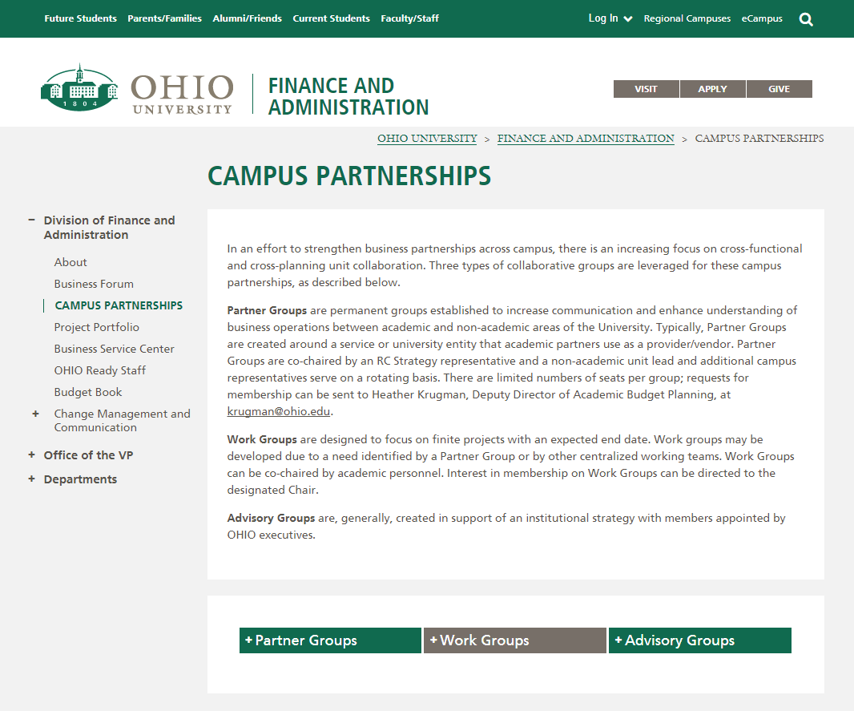
Partner Group Updates

Slide 45
Partner Group Updates
Partner Group rosters, mission and goals have been updated and are reflected on web pages
Hospitality Partner Group established email address for feedback: HospPartnerGrp@ohio.edu
Please send any updates to rosters, mission and goals for website to Jennifer Cochran at cochraj1@ohio.edu

Slide 46
Next Business Forum
Thursday, December 7, 2017 10 a.m. – 12 p.m.
Baker University Center Room 240

Slide 47
Financial System Enhancements
Leigh Casal: Change Management Associate, Finance and Administration
Bo Richardson: Data and Reporting Analyst, Budget Planning and Analysis

Slide 48
Agenda
Training and Readiness
FA View Demo
Questions

Slide 49
Training
Financial Approvers: 9/28 – 10/2
Chart of Accounts Fundamentals: 10/19 - 10/27
Grants Accounting Fundamentals : 10/24 – 11/2
Accounting with the new COA: 11/1 - 11/8
Report Fundamentals : 12/6 – 12/18
Casual User Systems & Tools: 12/8 – 12/18
Internal Awards Set-up: February
Faculty Training: February
Invites will go out this week
Invites will go out in mid-late October
Regional and extension campuses with receive an invite for remote option for all courses
 | September |  |  |  | October |  |  |  | November |  |  |  | December |  |  |  | January |  |  |  | February
FARM
COA FUNDAMENTALS
GRANTS FUNDAMENTALS
ACCOUNTING WITH COA
REPORTING FUNDAMENTALS
CASUAL USER
FACULTY
INTERNAL AWARDS
Invitations based on CFAO/Change Network discretion

Slide 50
Training Effectiveness
Finalizing COA Fundamentals, Grants Fundamentals and Accounting with new COA
Internal dry run and dry run with Change Network to ensure training is effective
Interactive Questions and Quick Reference Guides
Qualtrics evaluations after each session

Slide 51
Near-term Focus:
Training development and defining go-live and post implementation support
Continue to update mapping to reflect campus changes
Development of report definitions for General Ledger and Grants dashboards
Development of integrations and remediation as items are discovered in testing
Developing FAQs and updating COA Website

Slide 52
Upcoming Communication
Object Codes and definitions
Invitations to register for training
FA View Demos
Go-live schedule and support
Website updated with training materials

Slide 53
COA Resources
COA Website:
https://www.ohio.edu/finance/coa/
All COA information posted on website
Utilize site to check on COA project news and updates
FAQs
Change Network
Segment overviews
Questions?
Email COA@ohio.edu

