Slide 1
FY25 Annual CIP Update Budget Planning Council
April 8, 2024

Slide 2
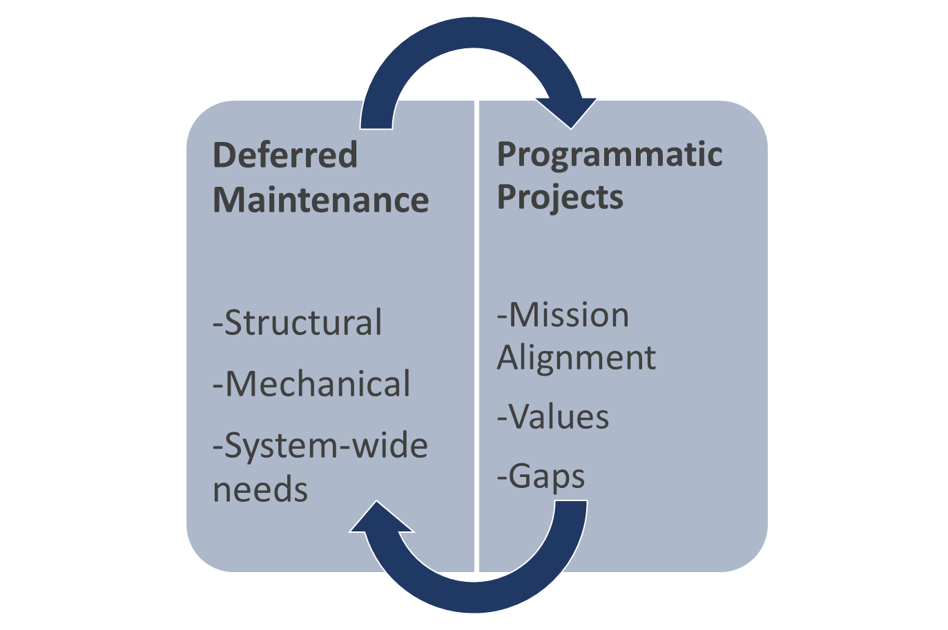
Capital Improvement Plan FY25 Annual Update Process
CIP is updated and approved annually
Typical approval in June of each year
Six-Year CIP in odd yrs./Annual CIP in even yrs.
FY25 Annual CIP is due to BoT in June 2024
Prioritized projects for FY25 were approved by BoT in June 2023 as part of the FY25-FY30 Six-Year CIP
Annual update process is designed to:
Validate assumptions, principles, and project priorities
Consider emerging key needs for inclusion

Slide 3
Annual Update Process for FY25
Review FY25 Priorities from approved FY25-FY30 CIP
List includes FY24 projects not started
Review FY25 plan with stakeholders
Update FY25 plan based on stakeholder feedback
Review available funds to allocate
Sources include project savings, change in strategy, or prior year funding residuals
Review priorities: existing and new needs
Discuss with leadership the strategy for use of available funds
Develop plan and seek approvals

Slide 4
FY25-FY30 CIP Principles & Assumptions
Support strategic objectives while maintaining investments for mission critical needs
Support Strategic Initiatives - Future of Higher Education, Enrollment, Student Experience
Funding for Portfolio Reduction, Programmatic Investments
Invest for meaningful impact, Covid Response, Right-Size Campus

Slide 5
State Funded CIP Projects - FY25 & FY24 Not Started
Chubb Hall Window Replacement | $1,400,000
OUZ HVAC & Energy Efficiency Ph2 | $2,870,800
Annual Steam System Repairs FY25 | $800,000
Chilled Water Plant 3 Chiller Expansion (+$3,300,000 from Housing) | $3,500,000
*COFA Renewal Strategy not shown (started in FY24)

Slide 6
Century Bond Funded CIP Projects - FY25 & FY24 Not Started
Convo Flat Roof Replacement | $1,000,000
HVAC Controls – Bentley Hall | $600,000
Annual Emergency Projects Fund FY25 | $500,000
Annual Steam System Repairs FY25 | $100,000
Masonry – In-House FY25 | $250,000
Painting – In-House FY25 | $250,000
Windows Repair & Replacements FY25 | $725,000
ADA FY25 | $250,000
*COFA Renewal Strategy and Convo MEP Upgrade not shown (started in FY24)

Slide 7
FY25 Annual CIP Schedule
February | March | April | May | June
Validate Assumptions & Project Priorities Analyze & Prioritize |  | Vetting |  | Finalization
Leadership Meeting Kickoff / Project analysis, prioritization, and funding | Stakeholder & CIP Committee Meetings as needed | Draft Plan Developed CFPC April 16 |  | Final FY25 Annual CIP Presentation to BoT for Approval June 13

