Slide 1
Instructions for Narration
To hear the narration:
Make sure your volume is turned up
On toolbar, selected Slide Show make sure ‘Play Narrations’ and ‘Use Timings’ is clicked
Under the same toolbar heading, choose either play ‘From Beginning’ or ‘From Current Slide’
Slides will advance automatically

Slide 2
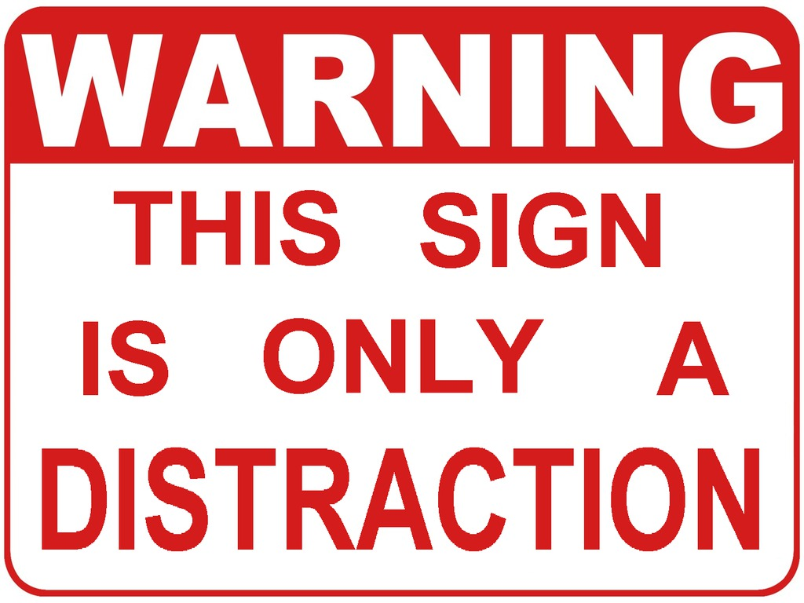
Distraction Tool

Slide 3
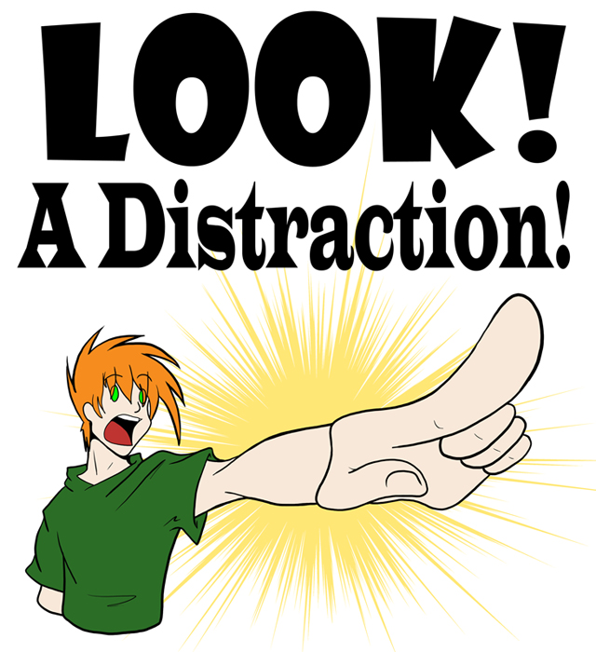
Purpose
Distractions are inevitable in work and life
Distractions can lead to safety and production issues
Goal of this tool → identify and reduce task distractions
Reducing task distractions will lead to safety and production improvements

Slide 4
Instructions
Whenever possible, this tool should be used by an observer watching an employee perform a specific task
When this is not possible, the employee performing the task can complete the form themselves, although this may not be as accurate because the tool itself may then become a distraction

Slide 5
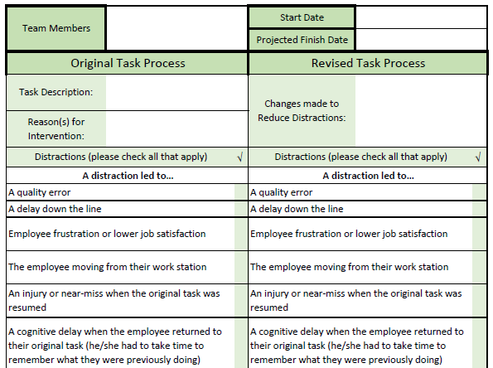
Headers
At the top fill in:
Team Members
Start Date
Projected Finish Date
After this, there are two columns to compare:
Original Task Process
Revised Task Process

Slide 6
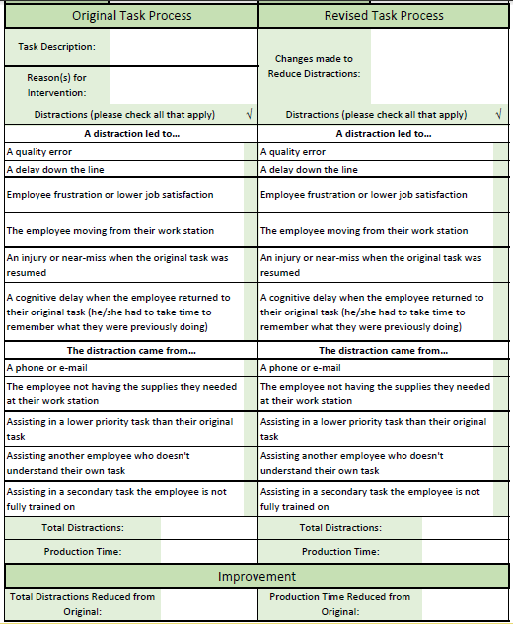
Original Task
Under the original task process side:
A thorough description of the task should be written ( include a picture if available)
The primary reason(s) for conducting an intervention (i.e. an injury occurred at this task or this particular task is a bottleneck for the entire process)
Distraction Points
There is a list of 11 distraction points
The observer should check off each distraction point that affects the employee during the task
At the bottom, record the total distractions and the current production time

Slide 7
Revised Task
The revised task process side:
Should be completed after revisions to reduce the distractions in the task have been made and documented
Observer should witness the employee perform the task but this time with the revised method
The total distraction and production time should be documented

Slide 8
Improvement
Improvement Section:
A simple area to document improvements to the process
The number of distractions and production time should be reduced from the original

