Slide 1
Business Forum
June 12, 2018
10 AM – 12 PM
HRTC 141-45

Slide 2
Facilities Partner Group
Steve Wood, Associate Vice President for Facilities Management and Safety
Kelly Broughton, Assistant Dean for Research and Education, University Libraries

Slide 3
Agenda
Review of Charge, Membership and Goals
Building Coordinators Initiative
Purpose and Goals
Responsibilities
Next Steps
Discussion
EAB and APPA Executive Dashboard
Key Performance Indices
Discussion

Slide 4
Facilities Partner Group CHARGE
The Facilities Partner Group is charged with developing solutions to improve processes and communications between planning units and the University’s Facilities Management.
The Facilities Partner Group will gather, review, and assist in the prioritization of issues related to custodial, grounds, and building maintenance and operations.

Slide 5
Representation
Planning Unit | Representative
Auxiliaries Services | Brent Buckley
Business Service Center | Marjorie Mora
Campus Recreation | Mark Ferguson
College of Arts and Sciences | John Gilliom
College of Fine Arts | Kari Saunier
Division of Student Affairs | Dustin Kilgour
Facilities Management and Safety | Steve Mack Jay North
Heritage College of Osteopathic Medicine | Dean Dupler
Intercollegiate Athletics | Jason Farmer
Patton College of Education | Ivy Crockron
Scripps College of Communication | Chris Stewart
Undergraduate Admissions | Kevin Witham

Slide 6
Facilities Partner Group Strategic GOALS
Complete SLAs for all three FMS areas
Make SLAs available to community
Define a shared understanding of responsibilities of building contacts
Create building contacts list
Continue to evaluate and implement efficiencies in service

Slide 7
Building Contacts initiative
Purpose: To improve maintenance operations by identifying primary contacts in each building who will serve as the main conduit for communications to and from Facilities Management.
Goals: To fill gaps in reporting, reduce redundancies in reporting, and streamline communications between facilities, building occupants, and building owners regarding facilities issues.

Slide 8
Building Contacts initiative-More
What are Facilities Issues?
custodial
grounds keeping
building maintenance and operations (lighting, heating, cooling, plumbing)
NOT: classroom technology or classroom furniture

Slide 9
Responsibilities of Building Contacts
Units in each building will have a primary designee and a backup designee who will be responsible for:
Notifying Facilities of issues needing their attention
Communicating with other building occupants when needed and as determined is appropriate by each unit within the building
Reporting staff changes to access control, when notified and as appropriate
~not intended to prevent other building residents from reporting issues and concerns

Slide 10
Responsibilities of Facilities to Building Contacts
Facilities staff will:
Copy the building contact on communications regarding open work orders in their building.
Provide automatic work order reports by building upon request.

Slide 11
Responsibilities of Other Building Occupants
Building occupants not designated as building contacts will:
Inform the building contact(s) of facilities issues, both reported and non-reported
Inform the building contact(s) of staffing changes within their units
Read communications from the building contact
Inform the building contact of the dates of major events within their unit, as well as any major programming or construction planned within the building

Slide 12
Building Contacts initiative NEXT STEPS
Finalize identification of contacts for all buildings
Communicate purpose and goals to all contacts
Ask for feedback and suggestions
Schedule building contact training
Best practices for work orders
Report Generation
FMS ongoing Initiatives and KPI

Slide 13
Building Contacts initiative Discussion Questions
What do we need to do to make sure this initiative successfully achieves our objectives?
Eliminate reporting/communication gap
Reduce reporting/communication redundancies
Streamline communications between Facilities, building occupants, and building owners
What are your suggestions for training and/or best practices development for building contacts?

Slide 14
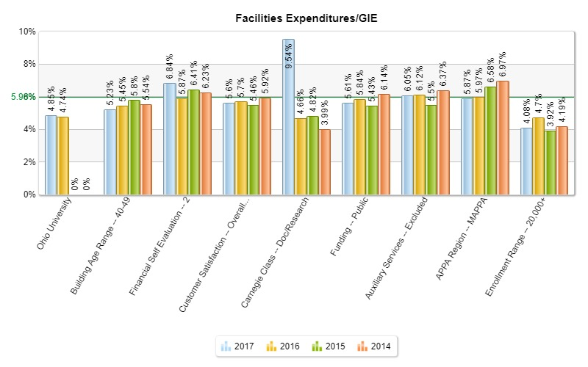
Annual Facilities Operating Expenditures/GIE
Adjusted gross institutional expenditures (2016: $ 648,139,758.00 2017: $ 76,217,876.00)
Annual facility operating expenditures (2016: $ 30,701,186.00 2017: $ 32,810,056.00)
****For the Adjusted gross institutional expenditures for FY17, use Total Operating Expenses $762,890,435 less Auxiliary enterprises $86,672,559 = $676,217,876
Notes:
Adjusted gross institutional expenditures (2016: $ 648,139,758.00 2017: $ 76,217,876.00)
Annual facility operating expenditures (2016: $ 30,701,186.00 2017: $ 32,810,056.00)
****For the Adjusted gross institutional expenditures for FY17, use Total Operating Expenses $762,890,435 less Auxiliary enterprises $86,672,559 = $676,217,876

Slide 15
MAPPA Members – Participated in FPI
States included in MAPPA:
Ohio, Illinois, Indiana, Iowa, Michigan, Minnesota, Wisconsin
Notables include:
The Ohio State University, Kent State University, Western Michigan University, Otterbein University, Michigan State University, The University of Chicago-Medicine, Minnesota State College and Regionals, Wright State University, Illinois State University, Illinois Institute of Technology, Lake Superior College, Northern Michigan University, Ashland University, John Carrol University, Sinclair Community College, Western Illinois University, Wheaton College, University of Illinois, University of Wisconsin-Madison & Stout, University of Iowa, University of Northern Iowa, University of Michigan-Flint, John Carroll University, Sinclair Community College
(92 total)

Slide 16
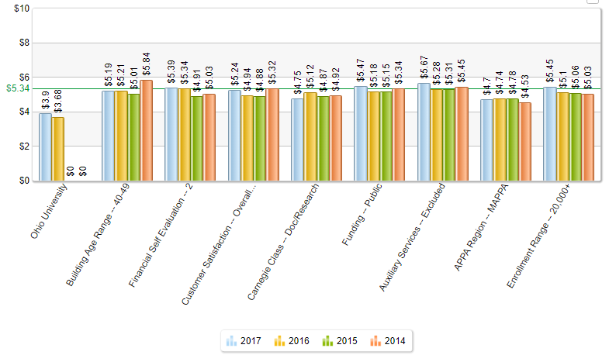
Facilities Management Cost per GSF (without purchase utilities
Notes:
Entire Facilities Management Budget 2017 (32,810,056.00) GSF-2017 (8,417,568.00) ------ TITLE: FM COST PER GSF (WITHOUT PURCHASED UTILITIES)
2016: $ 30,701,186.00 GSF 2016: 8,374,040

Slide 17
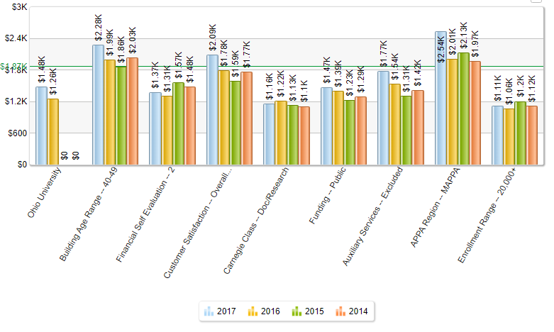
Total Operating cost per SFTE (without purchased utilities)
Notes:
Entire Facilities Management Budget 2017 ($ 32,810,056.00) and 2016 ($ 30,701,186.00)
Student FTEs : 2017 ( 22,143 students ) and 2016 ( 24,407 students )
****change from 2016 to 2017 was due to :
Student official FTE last year (2016) included online. This year (2017) from the Office of institutional Research (published 2017 and downloaded online), we used Athens Undergrad, Master, PhD, Osteopathic undergrad, Master, Phd (Athens Only, again).

Slide 18
Maintenance total cost per GSF
$1.17
Notes:
M&O Total Cost per GSF
Gross Square Footage = (2016: 8,374,040 2017: 8,417,568.00)
Total M&O Expenditures including benefits = (2016: $ 9,761,502 2017: $ 9,561,473)
Gloria – we need to adjust this graph – should be 2016: $ 1.17/GSF and 2017: $1.14/GSF. 2017 is correct, 2016 should be less @ $1.17/GSF not $1.31. Feel free to check my math using the numbers below, but those are the ones that I received from Marjorie this am.

Slide 19
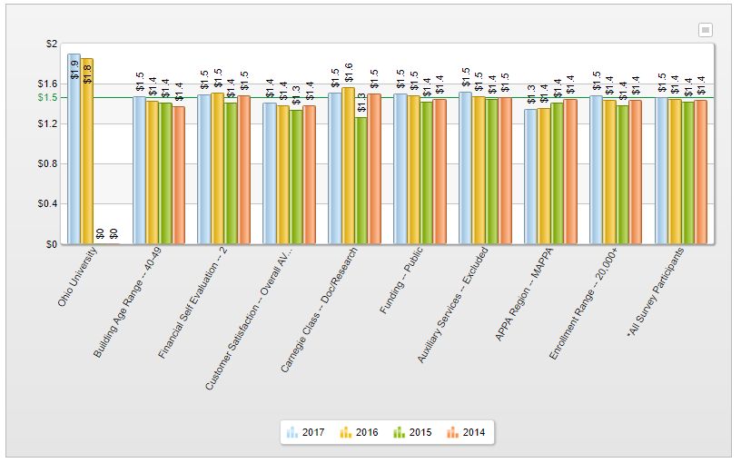
Custodial Total Cost per GSF
Notes:
GSF used for formula: 2016: 7,708,020 2017: 7,784,539
Total Custodial Expenditures: 2016: $14,232,171.00 2017: $14,775,841.00

Slide 20
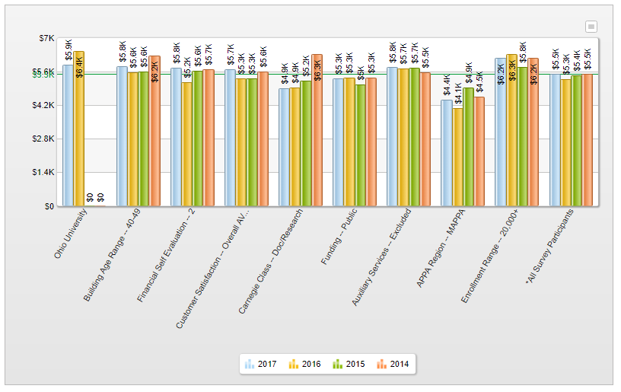
Grounds total cost per Acre
Notes:
Acres used for formula: 2016: 469 2017: 469 Total Grounds Expenditures: 2016: $3,023,212 2017: $2,747,898
*acreage used includes the building footprints, without footprint the total acreage is 403

Slide 21
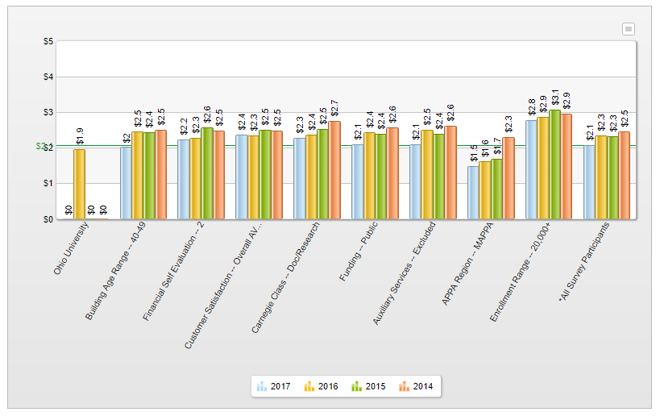
Energy Total Cost per GSF (with purchased utilities)
$1.8
Notes:
2016-17:
Total GSF = 8,417,568
Purchased Utilities = $ 12,602,530
Energy w/out Purchased Utilities = $ 2,500,000
Total MMBTU = 1,131,003.37 MMBTU
Energy Total Cost = $ 1.80

Slide 22
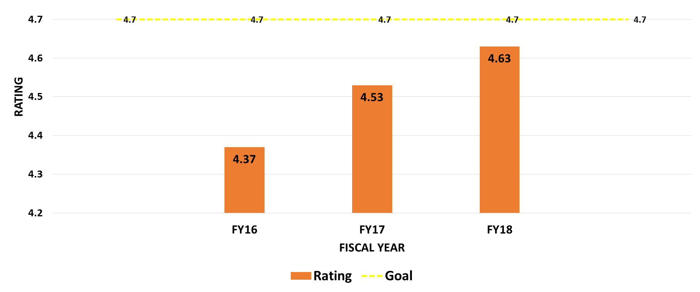
Overall Facilities Management Customer Service Rating (Last three years)

Slide 23
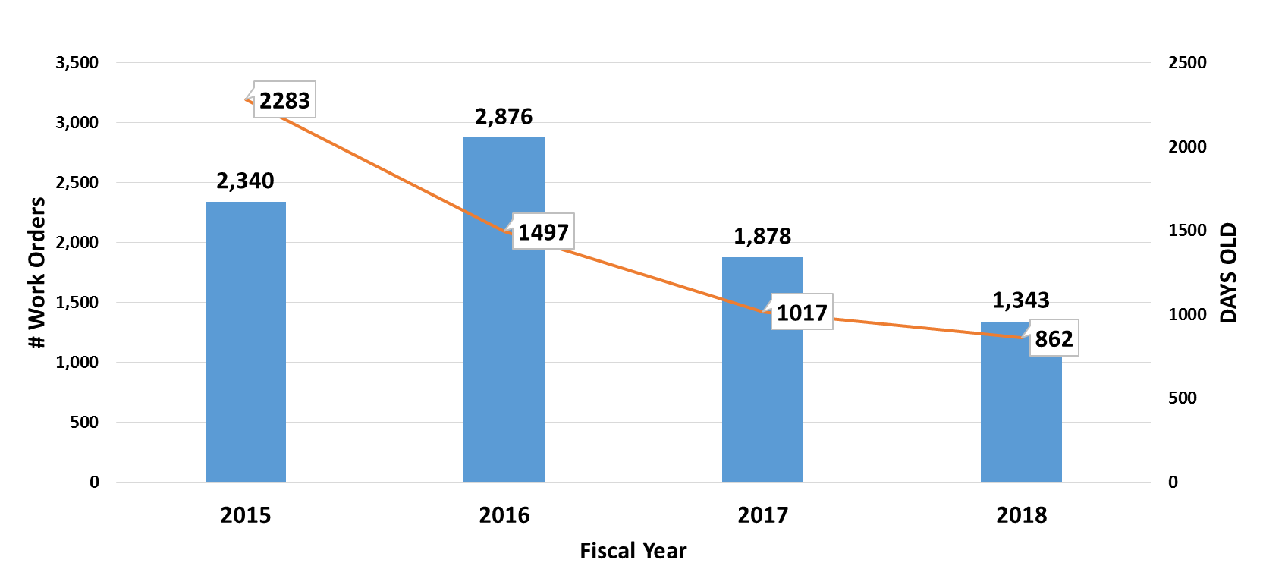
Work order backlog

Slide 24
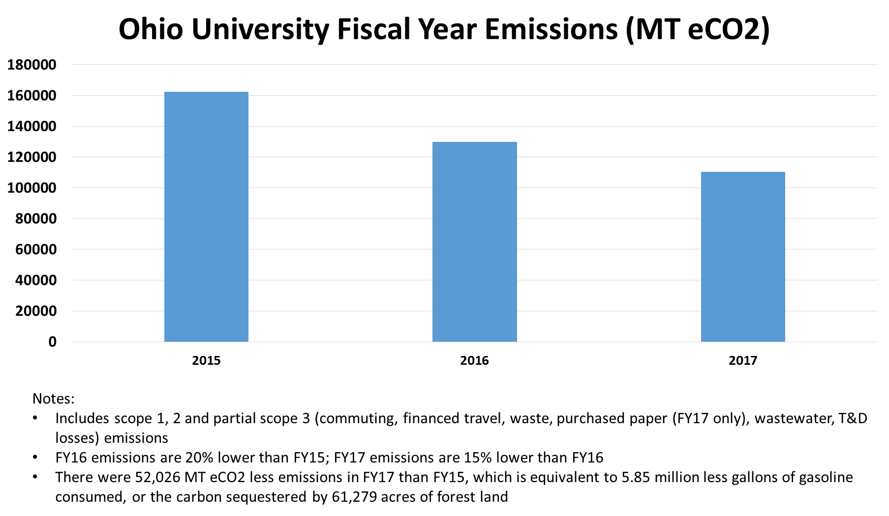
Ohio University fiscal year emissions (MT eCO2)
This graph shows that emissions at Ohio University have decreased from 2015 to 2017. Including scope 1,2 and partial scope 3 (commuting, financed travel, waste, purchased paper (FY17 only), wastewater, T&D losses) emissions. FY16

Slide 25
Discussion Questions
Did you find review of these Key Performance Indices useful? What would you like to see?

Slide 26
Questions
Kelly Broughton
593-2709
brought@ohio.edu
Steve Wood
593-2911
woods1@ohio.edu

Slide 27
Benefits Advisory Council
Greg Fialko, Senior Human Resources Director

Slide 28
Benefits Update
BAC Background
Budget Information
BAC Recommendations
Dependent Eligibility Verification Program

Slide 29
Benefits Advisory Council Background
BAC formed in March 2014
Charge: Analyze and make recommendations regarding university benefits and to consider financial sustainability, competitiveness, and fairness in recommendations.
14 Members include representatives from Faculty Senate (Co-Chair), Administrative Senate, Classified Senate, AFSCME Union, as well as a Dean, an Executive Dean, a Vice President, an Academic Chair/Director, an Associate Provost, and the Chief HR Officer

Slide 30
BAC Background
Guiding Principles
Eliminate structural deficits
Avoid Affordable Care Act Cadillac Plan Tax (required by state law)
Establish a maximum university contribution to the annual inflationary cost of benefits (no more than 5%)
Previous Recommendations have included a mix of
Premium increases: All employees pay more
Cost-Sharing Increases: Users of the plan pay more
Consumerism (Rx Advanced Utilization Review): Influence “smarter” utilization
Wellness: Supporting wellness via HealthyOhio rewards and web-based wellness platform, WellWorks 100 visit incentive, sponsor CHIP program, etc.

Slide 31
BAC Recommendations
Previous recommendations include (but not limited to):
Three year (FY16, FY17, FY18) plan to mitigate costs (5% goal) and avoid Cadillac plan tax included increases in deductibles, copays, out of pocket maximum and etc.
Increase the percent of premiums paid by employees
Changing benefits eligibility or staff to positions with an FTE of 0.75 or greater and appointment length of 4 months or longer (included grandfathering)
Offer new vision and short term disability plans
Ensure benefit plans provide coverage for transgender health care needs
Funding for HealthyOhio, specifically the VirginPulse wellness program web site
Adding Advanced Utilization Management Programs for Prescription Drug Plan
Prior Authorization, Step Therapy, etc. in addition to exclusive home deliver and generics preferred program
Elimination of HMO plan for Eastern Campus Employees
Conduct Dependent Eligibility Verification Program

Slide 32
Previous BAC Recommendations
Original 3-year Plan FY16 - FY17 - FY18
Options | FY15 | FY16 (July 2015) | FY17 (July 2016) | FY18 (July 2017)
 |  | Plan Change | Plan Change | Plan Change
Deductible | $200/$400 | $400/$800 | $450/$900 | $500/$1000
Co-Insurance Maximum | $1000/$2000 | $1500/$3000 | $1750/$3500 | $2000/$4000
Co-Insurance % | 90% | 85% | 80% | No change
Office Visit Copays | $20 | $25 | No change | No change
Rx Retail Copays | $10/$20/$30 | $20/$30/$40 | No change | No change
Rx Mail Copays | $15/$30/$45 | $25/$35/$55 | No change | No change
Premium | 15% - 15% - 15% | 15%-16%-17% | 15% - 17% - 19% | 15%-17.5%-20%
Other |  |  |  | Rx Advanced Utilization Review HMO Plan Elimination
Chart lists BAC recommendations for FY16-18 to gradually increase deductibles and co-insurance payments.

Slide 33
Budget Information
University’s health insurance plans continue to trend at 5-7% increase level (prior to plan design changes).
For FY19 minimal benefit changes are scheduled due to use of reserves and projected savings from the Dependent Eligibility Verification Program.
Health insurance premiums will increase by approximately 5.5%
Other premiums remain as is (dental, vision, life, and disability insurance)
Cost sharing remains as is (deductible, co-pays, out of pocket maximum, etc.)

Slide 34
Dependent Eligibility Verification Program
Purpose:
Maintain compliance with university policies and insurance plan documents
Maintain compliance with Federal rules regarding eligibility for pre-tax health plans
Ensure benefits funds are dedicated only to eligible individuals
Started November 13, 2017
Deadline was extended to February 13, 2018
Program was conducted by HMS. HMS has conducted similar programs for IUC institutions such as University of Cincinnati, Wright State, Youngstown State, and Toledo
Impacted 2,550 faculty and staff with 5,502 dependents enrolled in plans. The average cost per dependent for health care is $6,919 per year
98.8% of dependents were verified as eligible, with 1.2% (67) ineligible.
Program is expected to cost approximately $55,000
Cost savings of approximately $463,000.

Slide 35
Dependent Eligibility Verification Program - Data
Dependent Verification Summary
Total Dependents | 5,502
Verified Eligibility | 5,435 | 98.8%
Eligibility Terminations | 67 | 1.02%
Voluntary | 44
Voluntary – No Response | 15
Other | 8
Terminations by Employment Type
Employment Type | Count
Admin | 21
AFSCME | 20
Classified | 9
Faculty | 17
Total | 67
Terminations By Dependent Type
Dependent Type | Count
Spouse | 30
Child | 37
Total | 67

Slide 36
Budget Projections and Cost Savings Needed to Maintain 5% Goal
 | FY18 (Update) | FY19 | FY20 | FY21
Medical Claims | 43,675,000 | 46,737,000 | 49,067,000 | 51,140,000
Rx Claims | 11,097,000 | 12,061,000 | 13,227,000 | 14,394,000
Dental Claims | 2,403,000 | 2,292,000 | 2,384,000 | 2,479,000
Fees/Other Ins | 6,743,000 | 7,148,000 | 7,480,000 | 7,865,000
Total | 64,008,000 | 68,238,000 | 72,158,000 | 75,878,000
Use of Reserves |  | (969,450)
Premiums | (13,189,000) | (13,908,600) | (14,676,934) | (15,497,348)
Claims + Fees Net Premiums | 50,819,000 | 53,359,950 | 57,481,066 | 60,380,652
Percent Increase |  | 5.0% | 5.8% | 5%
Savings needed to reach 5% goal (Dependent on preliminary changes discussed at BAC) |  |  | 435,196 – 842,196* | 25,533 – 432,533*
Table details budget projections for FY18-21 with increasing costs of medical, prescription and dental claims as well as savings needed to maintain a premium increases of around 5%.

Slide 37
Current BAC Recommendations
Use of reserves for FY19
Use of reserves is an exception to the guiding principles
Exception recommended based on the following factors
Projected positive variance in the FY18 benefits budget
Impact of staffing levels on future benefits budget and standard rate not yet known
Availability of reserves while financial impact from benefit changes and staffing levels are determined
Use of dependent eligibility verification program savings for FY19
Increasing Out-of-Pocket Maximum for FY20 and FY21
Increasing employee percent share of premiums for FY20

Slide 38
Current BAC Recommendations Chart
Options | Current | FY19 | FY20 | FY21
Deductible | $500/$1000 | no change | no change | no change
Co-Insurance Maximum | $2000/$4000 | no change | $3,000 / $6,000 | $3,250 / $6,500
Co-Insurance % | 80% | no change | no change | no change
Office Visit Copays | $25 | no change | no change | no change
Rx Retail Copays | $20 / $30 / $40 | no change | no change | no change
Rx Mail Copays | $25 / $35 / $55 | no change | no change | no change
Premium | 15%-17.5%-20% | no change | 17% - 19% - 21% | no change
Other |  | Use of Reserves ($970K) Dependent Eligibility Program Savings ($360K) | To be determined | To be determined
Chart lists BAC recommendations for FY18-21 for small, incremental increases to co-insurance maximum. Deductibles, co-insurance percentage, and co-pays will remain unchanged in this time period.

Slide 39
BAC Future Considerations
Impact of changes on status of university plans compared to benchmarks
Potential for more impactful changes to health plans:
High Deductible Health Plan with Health Savings Accounts
Narrow provider network
Direct provider negotiation
Targeted/increased care management
Focused on target issues such as diabetes, or
Overall management of utilization (attempt to increase influence on utilization including directing care to high quality providers, “managing” high cost claimants, precertification of procedures, etc.)
Price Transparency tools
Quality tools/rankings
Domestic Partner Benefits policy review
Combining Faculty/Staff and AFSME Plans at next AFSCME negotiations
The “Cadillac Plan” excise tax in the Affordable Care Act is still in place for the year 2020. 40% tax for single plans in excess of $10,800 and family plans in excess of $29,050.
Etc.

Slide 40
Affordability & Efficiency
Julie Allison Assistant Vice President, Finance
Diana McGrew Assistant Director, Strategic Sourcing and Operations
Heather Krugman Deputy Director of Academic Budget Planning

Slide 41
Quick A&E reminders
Based on Governor’s Mandate
Ohio University is a late adopter
18-month rollout began May 2017
Ends in August 2018
Anything that CAN be purchased from a preferred supplier MUST be purchased from preferred supplier unless an exception has been granted

Slide 42
Preferred Suppliers
Ohio University expanded our preferred suppliers to include:
Ohio University direct bid suppliers
IUC and State suppliers
Suppliers awarded from other purchasing organizations in which Ohio is a participant
Ohio University continues to add new suppliers and catalogs for preferred suppliers. Recent additions include:
Staples
Major hotel chains
Web developers
Graphic designers

Slide 43
What happens if I want a different supplier to be Preferred?
The Finance website has a Preferred Supplier/Commodity Recommendation Form that you may use to request a certain supplier be notified next time Procurement goes out to bid
Procurement will be posting the schedule for bidding per commodity
Submission of this form does not guarantee that vendor will become preferred supplier, only that they will be asked to participate

Slide 44
Exception form
In the rare event that a good or service cannot be provided by a preferred supplier, an exception will need to be requested
Exception must be approved by planning unit CFAO prior to transaction
Exception is requested through BCB via compliance questions on the requisition
Form is highly recommended as the means to document the exception and should be attached in BCB or PCard (use of this form is not University mandated, but a recommended practice – please see your planning unit for additional guidance)
Exceptions will be reported annually to BOT and reviewed by internal audit

Slide 45
Other
FAQs are on the Finance website
BCB should be used whenever possible (not preferable, but possible)
This is in alignment with Board of Trustees PCard requests
If BCB shows a catalog, you may assume that is a preferred vendor
Even though we are working on some new providers, you need to use what we have for now
i.e. Altour for travel
Few quick items of high interest:
Books may still be purchased through Amazon or other suppliers Groceries may still be purchased from Walmart, Kroger, etc.

Slide 46
Still coming
More suppliers and catalogs are being worked on
New travel provider
Additional research support
Reporting for CFAOs to double-check exceptions are being requested when needed

Slide 47
Questions?

Slide 48
Badging and Certification Project
Lewis Mangen, Director of Organizational and Talent Development, Human Resources

Slide 49
Professional Development Pathways Launch
Official Launch: August 1st

Slide 50
Badging and certification project updates
Blackboard setup is complete
Historical training records entered – badges assigned
Purchasing and Accounting Certificates
Course development underway
Website updates
New and updated FAQs
Certificates and courses
Online registration is available for Search Committee Training and Performance Management for Non-Supervisors
Purchasing and Accounting Certificate structure outlines available
Education policies are in initial review

Slide 51
Payroll Announcements
Janice Gieseking, Payroll Senior Specialist, Human Resources

Slide 52
End of fiscal year reconciliation of leave usage
As the end of FY18 approaches, faculty and staff are reminded to record all planned and/or confirmed absences through June 30 in the appropriate system to ensure that leave balances are appropriately reflected and carried over into FY19.
Salaried faculty and administrators should refer to Absence Management in My Personal Information (MPI) to obtain current leave balances and should report all vacation and sick leave usage in Absence Management.
Classified and administrative hourly staff using WorkForce time entry can view up-to-date usage and balance information through WorkForce as data is entered and submitted each pay period. Earned PTO is added the first Friday of each pay period.
Last day to use Personal Days for FY18
Hourly Classified and Administrative Staff Saturday, June 23, 2018
Salaried Administrative Staff Saturday, June 30, 2018

Slide 53
Personal Days for FY19
On July 1, personal days for FY19 will be established.
For employees assigned eight-hour shifts with a sick leave balance of at least 120 hours (15 days), 24 hours of time will be converted.
For classified employees assigned 10-hour shifts with a sick leave balance of at least 150 hours (15 days), 30 hours of time will be converted.
All permanent and provisional full-time and part-time classified employees and administrators, who have a sick leave balance in excess of the amounts noted above as of the dates listed below, will have three days of sick leave time converted to personal leave for FY19.
Classified and administrative hourly staff may use their newly accrued personal hours on or after July 1, 2018. Please note that accrual totals will not be visible in WorkForce until July 2.
Salaried administrative staff may use their newly accrued personal hours on or after the pay period beginning July 1, 2018

Slide 54
Final FY18 Payroll Accounting Corrections
Final FY18 Payroll Expense Accounting Correction Forms are due no later than Friday, July 13.
Any corrections received after this date may not processed. Payroll only has until Thursday, July 19 to process them.

Slide 55
Next Business Forum
Tuesday, August 7, 2018 9-11 a.m. Baker University Center

