Slide 1
Business Forum
October 9, 2018
10 a.m. – 12 p.m.
Baker University Center 240

Slide 2
Post Awards and Grants Partner Group
Luanne Bowman, Russ College of Engineering and Technology
Cindy Perry, Grants Accounting

Slide 3
Agenda
Partner Group Charge
Representation
Goals
Roles & Responsibilities matrix – policies and procedures review
Grants Management Training
Institutional Base Salary – define and how impacts campus
Vacation & Sick leave

Slide 4
Post Awards and Grants Partner Group Charge
The Post Awards & Grants Partner Group is charged with developing solutions to issues that impact the application, implementation and accounting for external awards.

Slide 5
Representation
Co-chairs
Luanne Bowman, Russ College of Engineering and Technology
Cindy Perry, Grants Accounting
Membership
Wendy Kaaz, College of Arts and Sciences
Beth Tragert, College of Health Sciences and Professions
Greg Jolley, Heritage College of Osteopathic Medicine
Missey Standley, Heritage College of Osteopathic Medicine
Chip Rice, Patton College of Education
Shannon Bruce, Russ College of Engineering and Technology
Mike Finney, Voinovich School
Mo Valentine, Office of Research and Sponsored Programs
Keith Leffler, Vice President for Research

Slide 6
Post Award and Grants Partner Group Goals for FY 19
Current identified issues that have or will impact sponsored research
Roles & Responsibilities Matrix – polices & procedures
Grants Management training
Institutional Base Salary
Vacation/Sick Leave accrual
Current topics for discussion
Micro-purchase threshold implementation July 1, 2018
OBI reporting for overspent and closed PTAs

Slide 7
Uniform Guidance: Procurement Standards
Micro-purchase threshold standards:
Applies to federally funded purchases for goods and services
Micro-purchase means a purchase of supplies or services using simplified acquisition procedures, the aggregate amount of which does not exceed the micro-purchase threshold. Micro-purchase procedures comprise a subset of a non-Federal entity's small purchase procedures. The non-Federal entity uses such procedures in order to expedite the completion of its lowest-dollar small purchase transactions and minimize the associated administrative burden and cost. The micro-purchase threshold is set by the Federal Acquisition Regulation at 48 CFR Subpart 2.1 (Definitions). It is $3,000 except as otherwise discussed in Subpart 2.1 of that regulation, but this threshold is periodically adjusted for inflation.

Slide 8
Uniform Guidance: Procurement Standards
Effective July 1, 2018
Ohio University follows Federal Acquisition Standards which defines micro-purchase threshold at $10,000 per M-18-18 OMB Statutory Changes
Purchases on Federal Awards
Must have 3 quotes attached to requisition if AGGREGATE purchase per requisition against Federal Awards is $10,000 up to $50,000
Federal Awards (P-T-A smart numbering in Award)
11XXXXX-12XXXXX or 21XXXXX-22XXXXX

Slide 9
Uniform Guidance: Procurement Standards
Purchases from Preferred Suppliers – Do Not Require 3 Quotes
Competitive Bidding Already Occurred
University has determined pricing is reasonable under UG requirements
https://www.ohio.edu/finance/purchasing/preferred-suppliers
Federal Procurement Standards Quick Reference Guide
https://www.ohio.edu/finance/quick-reference-guides
Outstanding Questions
Purchase orders for consultant agreements that are effective July 1, 2018 or after must meet Procurement Standards

Slide 10
Grants Funds Available View Prompts – Overspent/Closed
Restrict to Overspent PTAs – select Y to view overspent PTAs
Include Closed Awards - select Y to view closed Awards
Include Closed Projects - select Y to view closed Projects
PTA with end date before – end date is entered to view PTAs ending within a specific time period

Slide 11
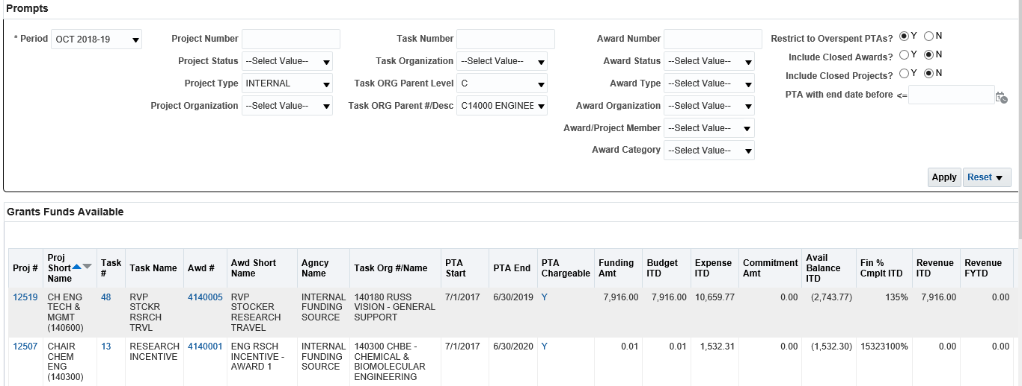
Example Overspent Prompt
Restrict to Overspent PTAs? Y
Project Type: Internal
Task ORG Parent Level and #Desc: Level C and Planning Unit

Slide 12
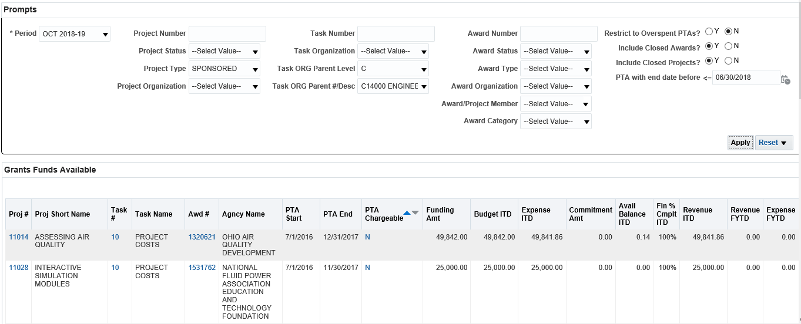
Example Closed Prompts
Include Closed Awards? Y and Include Closed Projects? Y
PTA with end date before: 06/30/2018
Project Type: Sponsored
Task ORG Parent Level and #Desc: Level C and Planning Unit

Slide 13
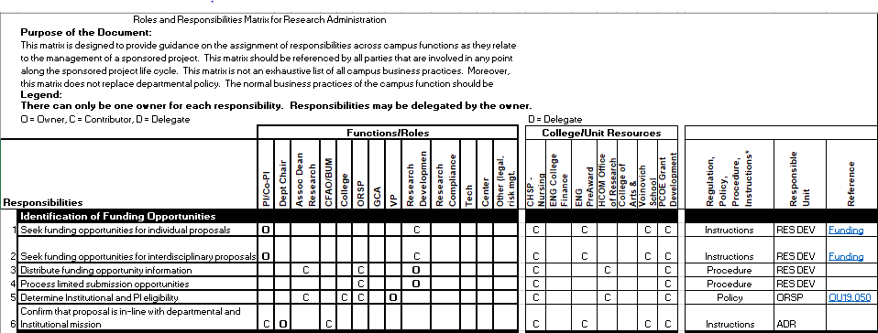
Roles & Responsibilities Matrix Draft
Identifying policy, procedure, regulation or instructions with unit responsible and reference

Slide 14
Discussion Questions
Are there post award, grant, sponsored research issues that the broader University community would like to see on this group’s agenda?
Luanne Bowman, bowmanl3@ohio.edu
Cindy Perry, perryc@ohio.edu

Slide 15
Compensation Partner Group
Kelly Coakley, Human Resources Compensation Megan Vogel, Division of Student Affairs

Slide 16
Agenda
Charge
Representation Changes
Goals

Slide 17
Compensation Partner Group Charge
The Compensation Partner Group is charged with reviewing existing policies and developing new policies and/or procedures regarding compensation of employees at Ohio University.

Slide 18
Representation
Kelly Coakley – Human Resources Compensation
Megan Vogel – Division of Student Affairs
April Ritchie – College of Arts and Sciences
Wendy Merb-Brown – University College
Eileen Theodore-Shusta – University Libraries
Tia Barrett – College of Health Sciences & Professions
Luanne Bowman – Russ College of Engineering and Technology
Heather Krugman – Scripps College of Communications
Brenda Noftz – Heritage College of Osteopathic Medicine
Bridget Driggs – Human Resources Payroll

Slide 19
Compensation Partner Group Goals
Review and revise Pay Administration Guidelines
Review and refine Reappointment process
Review and create compensation content for new HR website
Review and update job description template & supporting documentation

Slide 20
Questions
compensation@ohio.edu

Slide 21
Travel Provider Update Business Forum
October 9, 2018

Slide 22
Travel Provider Update
Agenda
RFP Timeline
Implementation
Training/Change Management
Travel Work Group
Travel Manager
Other Considerations Going Forward

Slide 23
RFP Timeline
May 2018 – RFP Release
June 2018 – Presentations
August - September 2018 – Negotiations
Expect Contract by end of September
October 2018 - Announcement

Slide 24
New Travel Provider is….

Slide 25
Travel Provider
Higher Education experience
Alabama, Virginia, Utah, Colorado Boulder, Colgate
Group travel experts – including international
24 Hour Service
Simplified and reduced pricing structure
Dedicated Travel Advisors to OHIO account
Experts in Fly America, grant travel, & NCAA
Specialists in group, student, & team travel
Exploring payment options with new vendor

Slide 26
Implementation
March 2019 – Expected Go Live
Concur Interface Changes
Upgrade to Concur User Interface
Travel Provider Changes
Policy Updates
Travel
Purchasing Card
Training/Communication & Change Management
Communication – Ongoing throughout project
Training expected February 2019

Slide 27
Training
Concur
User/Approver
Travel
Policy
How to Book Travel
PCard
Policy
Cardholder Training
How PCard will interface with travel

Slide 28
Travel Manager
Travel Manager
Contract with provider – needs to be negotiated
RC Strategy endorsed this option for one year trial (with possible extensions)

Slide 29
Other Considerations
Impact to PCard Program
New Payment Options for Travel

Slide 30
Questions

Slide 31
Contract & Insurance Matrix
Updated matrix posted late in August
Reviewed by Purchasing, Risk Management, and Legal Affairs
Key Changes:
New insurance guidelines aligned with IUC-RMIC guidelines – Stayed with 3 levels, Appendix A
Consolidated some service types, added additional
Re-evaluated risk levels
Catering
No longer different for Athens County
All caterers must show insurance and food license
Charter buses
Significant increase in insurance
Only use approved companies
Book through Transportation & Parking Services
Inflatables – rented inflatables not permitted on Short Form as entertainment.
Risk Management will evaluate case by case if supplier cannot meet insurance requirement

Slide 32
Purchasing RFP Plan
What is it?
Long-range look at bidding opportunities
Includes renewals of existing expense categories
New categories to bid
List of expense categories that have already been bid and required preferred suppliers named
Preferred supplier suggestions are incorporated
Should be posted to Finance website this week

Slide 33
Bobcatbuy training
BobcatBUY (BCB) Fundamentals
New to BCB
eLearning
Available in next couple weeks
BCB Advanced
Instructor-led
Available in early November
A&E Putting the Pieces Together in development
Buying and Contracting – TBD

Slide 34
Purchasing Third annual Supplier fair
Baker Center Ballroom
Wednesday October 10, 2018
10 a.m. – 1 p.m.
Join us!
50s theme
Over 60 internal and external suppliers
First 500 get goodie bags
Door prize raffle

Slide 35
Next Business Forum
December 13, 2018
9 – 11 a.m.
Baker University Center, Room 240

