Slide 1
Business Forum
Monday, August 7, 2017
Baker University Center 240

Slide 2
Agenda
Intro/Welcome
Employee Service Center Partner Group
Budget Partner Group
Hospitality Partner Group
Key Announcements

Slide 3
Employee Service Center Partner Group
Rosanna Howard, Director of Operations and Budget, Regional Campuses
Nick Wortman, Director of HR Services, Human Resources

Slide 4
Agenda
Partner Group Charge
Representation
Goals
Temporary Staffing Vendor Selection Process
Student Hiring Open Paperwork Sessions
Guide for Terminations and Separations
Search Committee Training

Slide 5
Employee Service Center Partner Group Charge
The Employee Service Center Partner Group is charged with developing solutions for employment and recruitment services and processes in accordance with goals determined by University leadership.
Areas of focus for improvement will include:
Communication
User needs and challenges
Technology and tools

Slide 6
Representation
Co –Chairs
Rosanna Howard
Nick Wortman
Members
Kim Hayden
Jennifer Martin
Lisa Poston
Deanna Russell
Angela Spangler
Megan Vogel

Slide 7
Goals
AY 2016-2017:
Updated “How-to” documentation for hiring processes on UHR Website
Terminations/Separations documentation on UHR website
Selection of vendor(s) for Temporary Staffing Services
AY 2017-2018
Group meets bi-weekly
Will be reviewing our mission and establishing goals in August
Please contact a group co-chair or member if you have an idea that you would like to see us work on!

Slide 8
Temporary Staffing Vendor Selection Process
Over 18 responses to our RFP
On-campus vendor demonstrations have been completed
Selection committee will be making final recommendations this week
Rollout Forums will occur after final contract(s) are negotiated

Slide 9
Student Hiring Sessions
Open hiring sessions to assist students with paperwork
No appointment necessary
Baker Center 237 from 9 a.m. – 1 p.m.
Monday, August 28 – Friday, September 1, 2017
Information related to hiring student employees is available online at:
https://www.ohio.edu/hr/payroll/hiring_students.cfm

Slide 10
Guide to Terminations, Resignations, and Retirements
Delineates mass termination schedules and associated lookback periods
Provides information regarding termination of TERM and TEMPORARY employees and
Provides guidance on notifying Human Resources of resignations and retirements
https://www.ohio.edu/hr/employment/leaving/upload/Termination-Schedule-Spreadsheet.pdf

Slide 11
Search Committee Training
Module 1
geared towards search committee chairs
focuses on recruitment, establishing inclusive search committees, introducing bias, and writing inclusive job descriptions
Module 2
geared towards search committee members
focuses on inclusive candidate evaluation and selection processes
discusses the impact of bias during these stages

Slide 12
Search Committee Training
VIP Access to ongoing developmental opportunities
Monthly Newsletter
Monthly Lunch and Learns
Topics include:
“Fit” – the good and the bad
Flex options and recruiting
Micro aggressions
Recruiting workshop
The use of social media in recruitment and selection

Slide 13
Search Committee Training
Sessions offered monthly by Human Resources
https://www.ohio.edu/hr/employment/search/
Click on “Upcoming Sessions” to sign up
Sessions for your college/department/office can also be scheduled by contacting your HR Liaison

Slide 14
Questions?
Please contact Employee Service Center Partner Group Co-Chairs:
Rosanna Howard
740-593-0321
stclairr@ohio.edu
Nick Wortman
740-597-2542
wortmann@ohio.edu

Slide 15
Budget Partner Group
Mike Finney, Chief Financial and Administrative Officer, Voinovich School of Leadership and Public Affairs
Katie Hensel, Budget Director, Budget Planning and Analysis

Slide 16
Agenda
Budget Partner Group Charge
Budget Partner Group Representation
FY18 Budget Partner Group Goals
Measuring Success in Achieving FY18 Goals
Upcoming Areas of Focus
FY18 Budget Update
FY19 Budget Implications

Slide 17
Budget Partner Group Charge
To facilitate productive communications between the planning units and the Office of Budget Planning and Analysis to enhance the tools, training, and resources that make the annual budgeting process efficient and meaningful.

Slide 18
Budget Partner Group Representation
The Budget Partner Group is co-chaired by the Director of Budget Planning and Analysis and a member of the RC Strategy Group, as selected by the RC Strategy Chair. The RC Strategy Group Co-chair will serve a two-year term. All campus planning units will have one member on the committee.
New RC-Strategy Co-Chair:
Mike Finney, CFAO of the Voinovich School of Leadership and Public Affairs

Slide 19
FY18 Budget Partner Group Goals
Enhance existing tools and develop new tools that facilitate efficient budgeting under the new Chart of Accounts
Train members on how to effectively budget with the new Chart of Accounts
Facilitate dialogue among members to encourage the sharing of ideas and techniques used across the University for effective budgeting
Better communicate the status of the University’s strategic priorities and budget process

Slide 20
Measuring Success in Achieving FY18 Goals
Conduct annual survey to determine if BPA guidance and budget tools have:
Saved planning units time and effort when creating their FY19 budgets?
Assisted planning units in developing their FY19 budgets based on the new COA?
Assisted planning units in successfully meeting budget reporting deadlines?
Other measures of success:
Monitor the budget to actual year end balances with the hope of increasing accuracy over time.

Slide 21
Upcoming Areas of Focus
FY19 Budget Development
Chart of Accounts – facilitate COA planning and transition issues that result from the November conversion
Templates and Tool Development:
COA Salary Diagnostic
Training & Reporting:
Budgeting with the new COA
OBI Financial Reports: TBS View

Slide 22
FY 18 Budget Update
The FY18 Budget Planning, Revenue Assumptions:
200 Fewer Undergraduate Students (Athens Main)
0% Tuition Growth for Continuing Students
1.3% (CPI) Tuition Growth for 2017-18 Guarantee Cohort
0% SSI
Final State Operating Budget and Enrollment Updates:
Continuation of an Undergraduate Tuition Freeze
0% SSI
Fall 2017 Enrollment: Projecting more than 250 fewer students

Slide 23
FY 19 Budget Implications
The FY19 Budget Planning, Preliminary Assumptions:
0% Tuition Growth for Continuing Students
5-Year (CPI) Tuition Growth for 2018-19 Guarantee Cohort
0% SSI
Athens Main UG Enrollment: PENDING
FY19 will likely be a continuation of the FY18 Budget Process in which new revenues and strategic realignments of budget priorities will be essential tools in the planning process.

Slide 24
Questions?
Please contact Budget Partner Group Co-chairs:
Mike Finney finney@ohio.edu
Katie Hensel hensel@ohio.edu

Slide 25
Hospitality Partner Group
Phil Taylor, Chief Operating Officer, College of Business
Gwyn Scott, Associate Vice President for Auxiliaries

Slide 26
Hospitality Partner Group Vision
Enhance University stakeholders’ awareness of the impact of event and service excellence in creating “Bobcat-brand” ambassadors.

Slide 27
Representation
Janice Bailey-Magill, Russ College of Engineering and Technology
Emily Chapman, Scripps College of Communication
Michael DePerro, College of Business
Dusty Kilgour, Division of Student Affairs - Event Services
Beth Lydic, Patton College of Education
Tina Payne, Division of Finance and Administration
Pete Trentacoste, Division of Student Affairs - Housing and Residence Life
Megan Vogel, Division of Student Affairs
Kathy White, Honors Tutorial College
Co-chairs
Phil Taylor, College of Business
Gwyn Scott, Division of Student Affairs - Auxiliaries

Slide 28
Hospitality Partner Group Charge
The Hospitality Partner Group will collaborate to successfully represent Ohio University to internal and external clients and guests.

Slide 29
Hospitality Partner Group Goals
Centralize event scheduling and resource support
Create an intuitive solution for guests to connect with centralized event planning services
Coordinate communication and engagement efforts to gather feedback, promote initiatives and evaluate enhanced customer experience strategy

Slide 30
Questions?
Please contact Hospitality Partner Group Co-Chairs:
Phil Taylor
taylorp@ohio.edu
Gwyn Scott
740-593-4155
scottg@ohio.edu

Slide 31
Financial System Enhancements
Renee Mascari: Manager, Project Management Group
Leigh Casal: Change Management Associate, Finance & Administration

Slide 32
Agenda
Conversion Schedule & Mapping Deadlines
Training & Readiness
Upcoming communication
Near-term focus recap
Questions

Slide 33
General Ledger Mapping Updates
Finalizing hierarchies and segment definitions
Refining conversion reports in the effort to streamline understanding of old to new accounting structure project team continues development on core financial reporting
GL Conversion Timeline & Important Dates
Conversion Results in OBITST August 21
Mapping changes due for September September 7
Conversion Results in OBITST October 2
Mapping changes due for go-live October 12

Slide 34
Grants Mapping Updates
Sponsored projects
Team is currently performing SIT testing
Capital projects
Finalize object codes defining accounting processes, and developing reporting requirements.
Team is currently performing SIT testing
Internal Awards
A subset of Internal Awards is available with the current conversion
Meeting with individuals from Planning Units to review their Internal Award mapping approach
Access to view Grants mapping will be provided to Planning Units in August

Slide 35
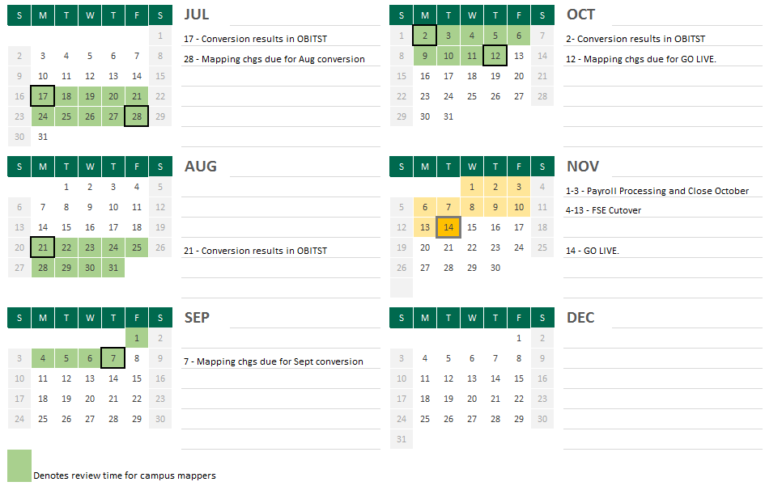
Tentative Mapping Schedule

Slide 36
Training & Readiness
Training Schedule & Curriculum developed
Training topics and timelines in August Compass & Business Matters
One-on-One meetings:
Review training schedule and finalize who should attend
Discuss strategy and support for casual users
Notes:
The Budget Planning and Analysis Office will facilitate an optional training opportunity in May to help units that want to participate to think about how they could budget differently in the current COA to prepare for a smoother transition to the new COA come November. In addition, the training will provide an opportunity to discuss the FY19 budget process, and help the Budget Office determine how to adjust templates, tools, and guidance to support the FY19 planning process. An invitation to register for participation was sent to representatives from each Planning Unit on April 26.
Each month, a feature of the Financial System Enhancements will be highlighted in order to help prepare for the upcoming changes.

Slide 37
Training Timeline
Course | Delivery
COA Fundamentals | Mid-September – Early October 2017
Accounting with the new COA | Late September – Mid-October 2017
Grants Accounting Fundamentals | October 2017
Report Fundamentals | Mid-Late October 2017
Faculty Specific Training | November 2017
Casual User Training | November 2017
Detailed curriculum published on COA website: Campus Involvement

Slide 38
Upcoming Communication
Screenshots of BobcatBUY, Concur, and Workforce
Project-Task-Award
Object Codes & Definitions
Invitations to register for training
Planning Unit Mappers:
Notification when converted data is available
Access to view Grants Dashboards

Slide 39
Near-term Focus:
Improve conversion process and develop complete cutover plan/timeline
Training development and defining go-live and post implementation support
Continue to update mapping to reflect campus changes
Development of report definitions for General Ledger and Grants dashboards
Development of integrations and remediation as items are discovered in testing
Developing FAQs & Updating COA Website

Slide 40
COA Resources
COA Website:
https://www.ohio.edu/finance/coa/
All COA information posted on website
Utilize site to check on COA project news and updates.
FAQs
Change Network
Segment overviews
Any questions?
Email COA@ohio.edu

Slide 41
Individual Compensation Distribution
Leigh Casal: Change Management Associate, Finance and Administration

Slide 42
Project Team
Human Resources
Project Sponsor Colleen Bendl
Project Manager Branda Lencioni
Functional Leads Kelly Coakley & Bridget Driggs
Change Management & Communication
Leigh Casal
Financial & Administrative Systems
Misty Riffle
Office of Information & Technology
Laura Dalton
Becky Brown
Ruben De Oliveira
Advisory Groups:
RC Strategy
Compensation Partner Group
Payroll Partner Group

Slide 43
Project Objectives/Scope
Replace current additional compensation and contract processes performed in Employee Management System (EMS) in coordination with the Chart of Accounts redesign
Implement Oracle functionality: Individual Compensation Distribution (ICD)
Eliminate paper processes to initiate and approve compensation distributions

Slide 44
Processed to be handled in ICD
Replace EMS functionality:
Academic Term Pay
Instructional Overload
Non-Instructional Overload
Part-Time Contract Pay
Summer Research
Summer Term Pay
Contract Pay
Early Retiree Pay
Added functionality:
Additional Salary
Additional Pay
Fiscal Increments
Awards

Slide 45
Benefits
Cost of remediating EMS for the new Chart of Accounts
Reduction in number of paper processes associated with processing additional compensation (overloads)
Enhanced approval workflow capabilities of ICD
Eliminate system limitations in EMS
Long term strategy of moving Financial and HR related processes into Oracle

Slide 46
High Level Timeline
Milestone | Timeframe
Project Kick-off | May
Requirement Gathering | June/July
Build | August
Testing | September
Training | October/November
Go-live | November

Slide 47
Next Steps
Feedback on Overload policy: Due 8/8
Continue using EMS as usual
Look for communication in September/October regarding:
Training and access details
Rollout schedule
Details regarding when EMS will be retired

Slide 48
Questions
Related to EMS:
payroll@ohio.edu
Related to ICD:
compensation@ohio.edu

Slide 49
Finance Website Redesign
Leigh Casal: Change Management Associate, Finance and Administration

Slide 50
Project Objectives
Enhanced visibility and greater awareness of:
Finance and Administration Division
Finance
Through the redesign, or creation of customer-friendly, dynamic websites and pages:
Improved communication with campus
Improved experience for website users
Reduced bounce rate

Slide 51
Project Team
Steering Committee
Amanda Davis
Chad Mitchell
Julie Allison
Core Project Team
Amanda Davis: Sponsor
Chelsie Wollett: Functional Lead & Systems Lead
Jennifer Cochran: Project Manager
Leigh Casal: Change Management Lead & Technical Lead
Extended Project Teams
University Communications & Marketing: Design support
Web Services: Development
All Departments within Finance: Subject Matter Experts

Slide 52
Finance Website – Major Milestones
Milestone | Timeframe
Department Interviews | January
Current Usage Assessment | February
Focus Group – Card Sort | February & March
One-on-one Interviews – Tree Sort | March
Decision to participate in WebCMS Pilot | April
Bursar website launch | April
Finance & Administration website launch | May 2017
Payroll pages migrated to HR site | June/July 2017
Finance website launch | August 2017
Training for editors | August 2017

Slide 53
Major Improvements
Based on function, not department
Accounting & Reports, Budget, Purchasing & Payments, Travel, Systems, Capital Projects, Treasury, Resources
System information & logins
Searchable tables
Forms, preferred suppliers, purchasing grid, insurance matrix
Consolidated training
Business Matters
Mobile friendly, responsive and accessible
 | Old Site | New Site | Percent Decrease
Pages | 586 | 80 | 86%
Documents | 2978 | 291 | 90%

Slide 54
Additional Details
404 Errors, redirects, and updated links
Missing content vs. Modified content
Supported Browsers
Internet Explorer 11
Microsoft Edge
Firefox 5.x and later
Safari 5.x and later
Opera 12 and later
Google Chrome

Slide 55
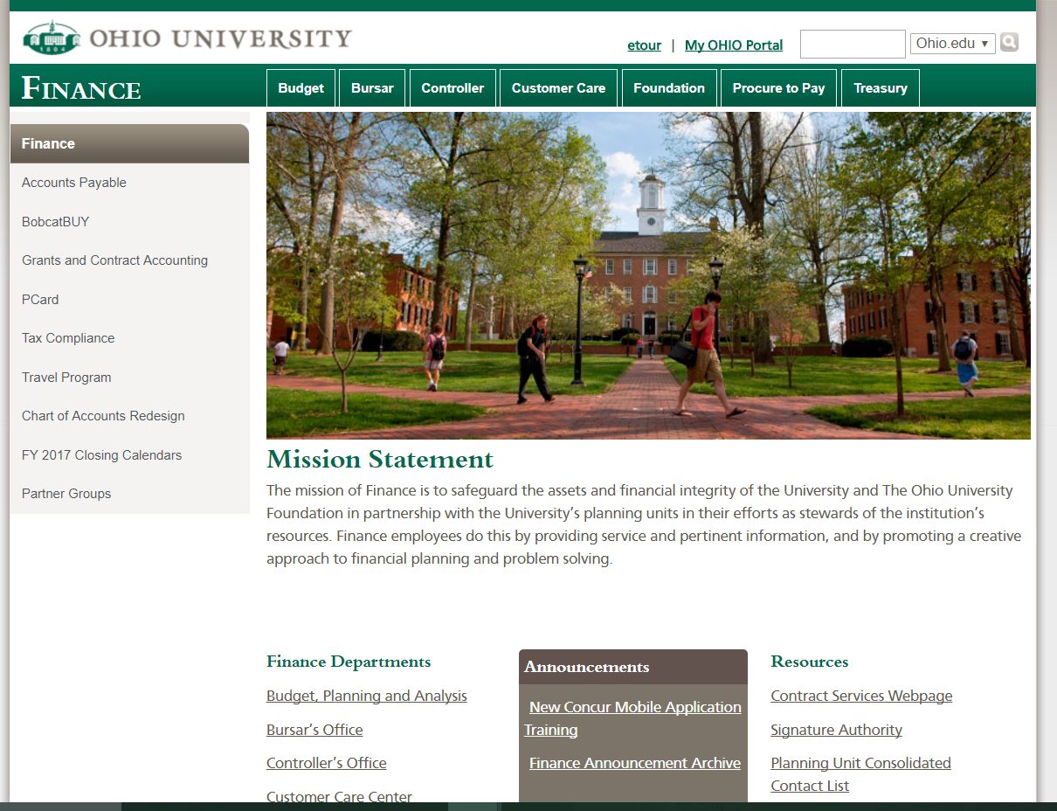

Slide 56
Questions
Finance Customer Care
financecustomercare@ohio.edu
740-597-6446

Slide 57
P2P Improvements Project
New and Improved!
We will be implementing the following changes
Process Changes
Form Changes
Streamlined Requisition Workflow
Removal of steps and change of hard stop approvals to reports and notifications for faster processing
Use the Payment Request Form to:
Process direct payments, honorariums, participant payments, reimbursements and refunds
Use supplier onboarding and maintenance streamlined process
Submit supplier set up and maintenance documentation through BobcatBUY Forms (Payment Request Form and Non-Catalog Items From) to complete both the supplier entry/maintenance and payment process to and avoid double entry of information
Use the Payment Dashboard to track payments
BobcatBUY Forms
New Forms: Payment Request
Service Agreement (all service agreements in one place, limit duplicative entry of information)
Removed Forms: Direct Payment
Honorarium Requisition
ICEZ, IC Comprehensive
Service Agreement PO
Purchasing Forms
Supplier/Payee Information Form (to be used with the standard IRS W9/W8 form)
Updated Honorarium Agreement
New tools to help you process payments through the Payment Request Form:
Participants Form
Awards, Prizes & Gifts Form
Refunds Spreadsheet
Notes:
Due to unforeseen circumstances outside of the project, we will be postponing the launch of the P2P changes. We are working to define the dates for training and the rollout of these changes. We will be posting communications on the finance website, in BobcatBUY, and in Compass as dates are decided.

Slide 58
Governor's Task Force on Affordability and Efficiency (AE Workgroup)
We are making headway in the AE Work Group
Find the list of preferred vendors on the Finance website
Remember: it is important to use the preferred vendors as much as possible
Contact the work group with any ideas: AE-Purchasing@ohio.edu

Slide 59
Q&A Next Business Forum
Thursday, October 10, 2017 2-4 p.m.
HRTC 141-145

