Slide 1
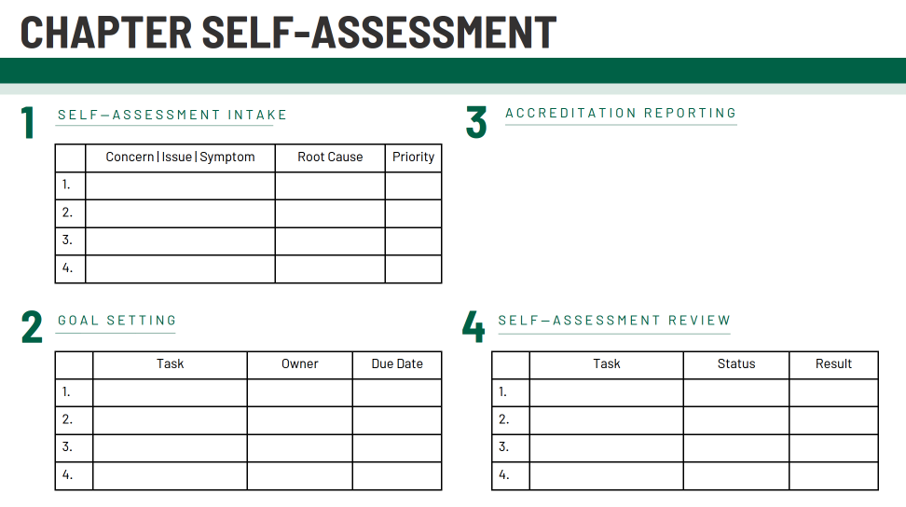
Office of Sorority & Fraternity Life Pawprint Accreditation Program presented by Ariel Tarosky, Director of Sorority & Fraternity Life
PROBLEM SOLVING
Chapters will be able to propose one or more solutions/hypotheses that indicates a deep comprehensive of the problem. Solution/hypotheses are sensitive to contextual factors as well as all of the following: ethical, logical, and cultural dimensions of the problem.
Chapter executive teams will meet with their chapter coach at the start of each semester to discuss the concerns and opportunities for growth within each of the accreditation areas (Table 1). Leadership will then work on identifying 1-3 opportunities for improvement in each criterion and aligning 1-3 goals per symptom (Table 2). Chapters will work with SFL staff periodically throughout the year to achieve stated goals which are then assessed by chapter leadership in February/March of each academic year (Table 4).
EDUCATION, INTERVENTIONS
& IMPLEMENTATION
Students will learn this information through our Chapter Accreditation program, called the Pawprint Program which includes a Chapter Self-Assessment, Strategic Plan, and Review. Information on how to best approach each stage of the Pawprint is provided to chapter presidents and leadership teams in the Pawprint manual and discussed through monthly Chapter Coaching sessions.
Chapter leadership is encouraged to work on Pawprint submissions throughout the year with their chapter coach.
2020-2021 CHAPTER COACHES
& PAWPRINT EVALUATORS
Ariel Tarosky, Director
Jeremy Paul
Justice Burda
Stephen J. Black
2020-2021

Slide 2
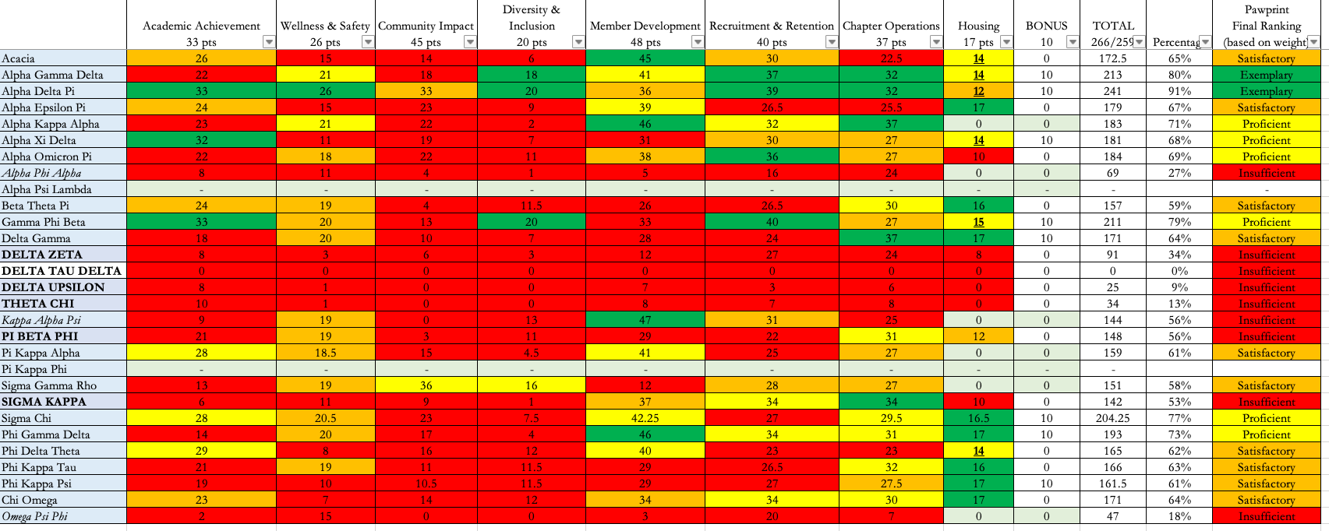
TIMELINE
AUGUST
Chapter completes the self-assessment & identifies/prioritizes chapter issues. Additionally, chapter begins to meet with chapter coach around academics & housing.
SEPTEMBR
Chapter continues to meet with chapter coach, focusing on wellness & safety.
OCTOBER
Focus is on community impact.
NOVEMBER
Focus is on diversity & inclusion,; some groups prepare for leadership transitions.
DECEMBER
Focus is on member development.
JANUARY
New officer training. Focus is on recruitment & retention.
MARCH
Chapter submits final materials and completes final assessment review.
FEBRUARY
Focus is on chapter operations.
CRITERIA ASSESSED
ANALYSIS
IMPLICATIONS & NEXT STEPS
The Pawprint Accreditation program included eight areas of assessment: Chapter Operations, Academic Achievement, Diversity & Inclusion, Member Development, Health & Wellness, Recruitment & Retention, Housing, and Community Impact. Each criterion was developed based on industry standards and community need as a result of the 2019 external review.
To begin, chapters establish at least 4 goals in each of the 8 assessment areas that correspond to the issues/hypothesis that were created in their chapter self-assessment. These were then prioritized based on urgency for improvement and used as a framework for the chapter’s strategic plan.
OSFL has already conducted focus groups and surveys with chapter leadership to identify areas for improvement for the 21-22 year. Additional opportunities for chapter trainings have been scheduled, assessment criteria has been revised, and new equitable structures have been developed..

